Slide 1
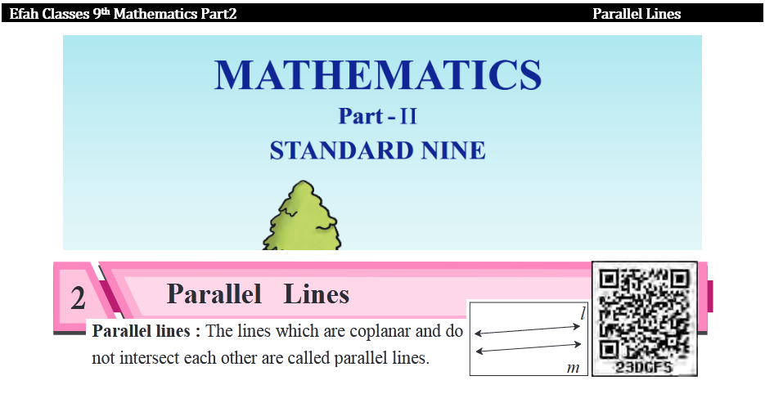

Slide 2
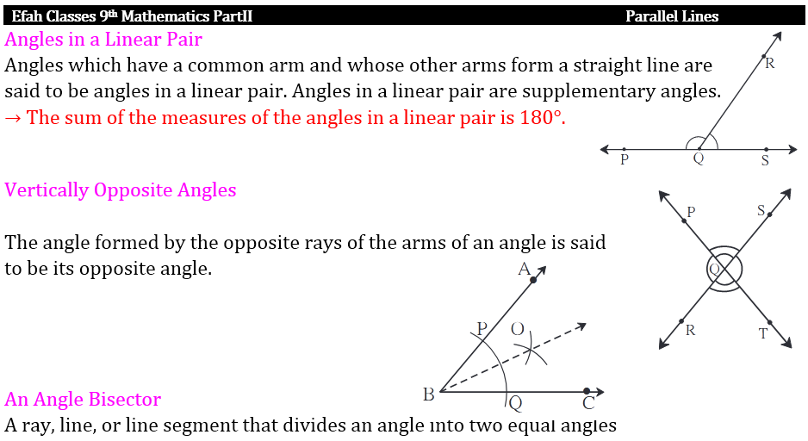

Slide 3
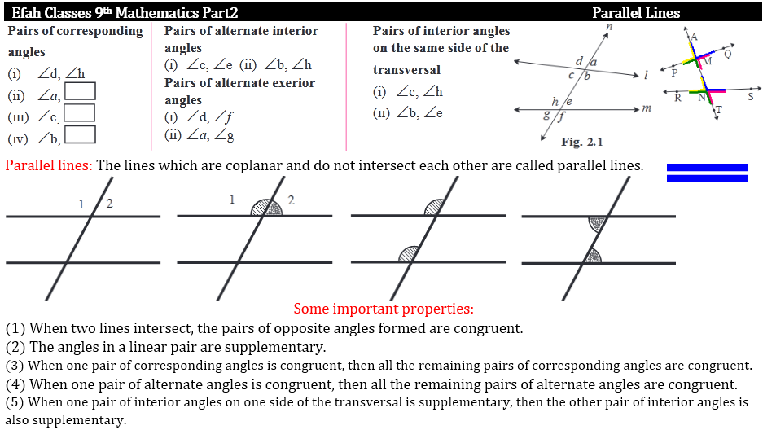

Slide 4
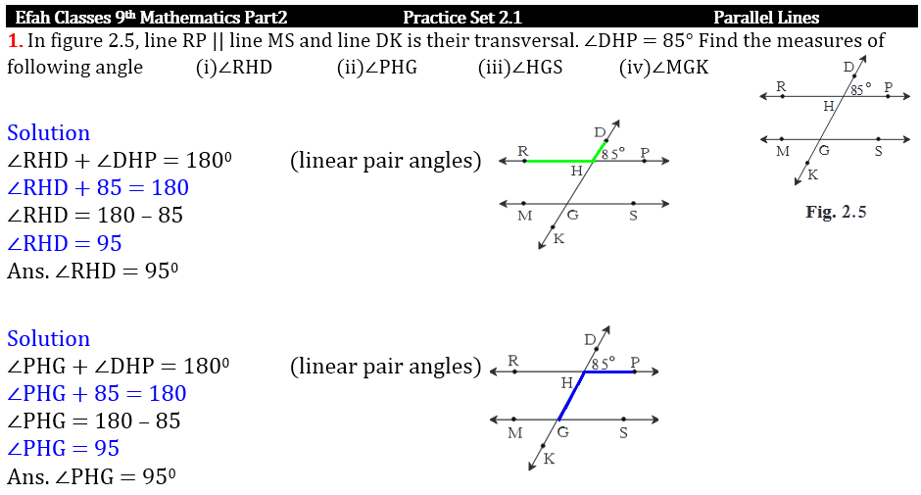

Slide 5
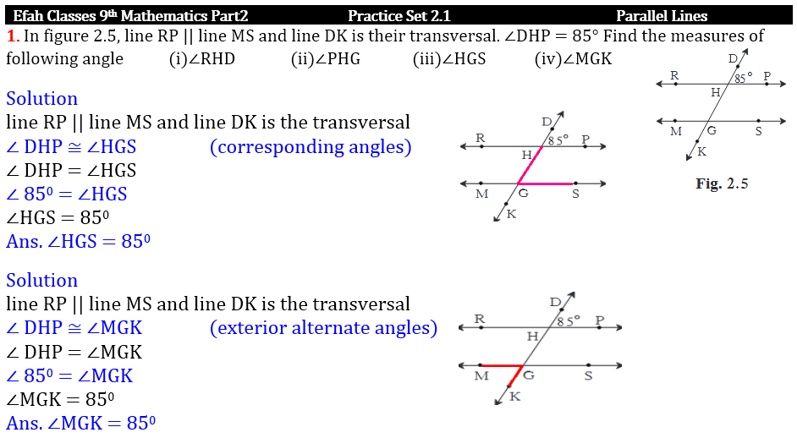

Slide 6
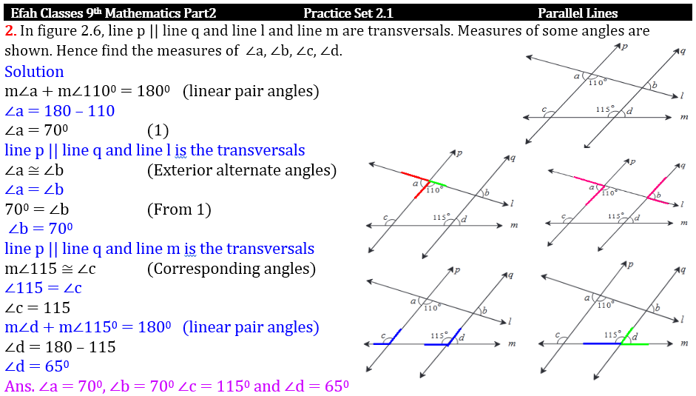

Slide 7
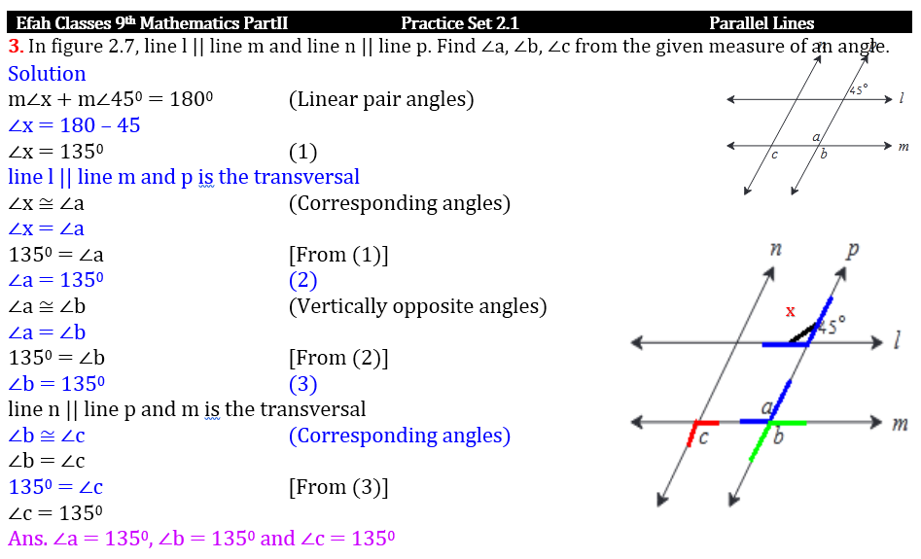

Slide 8
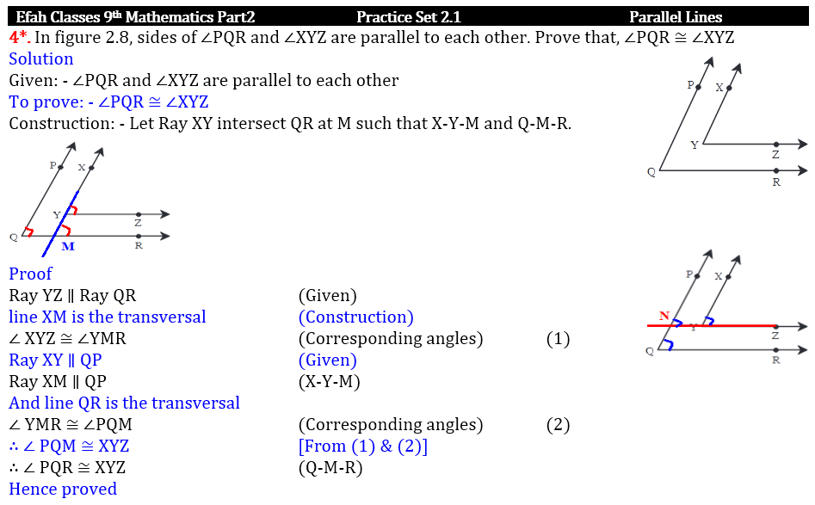

Slide 9
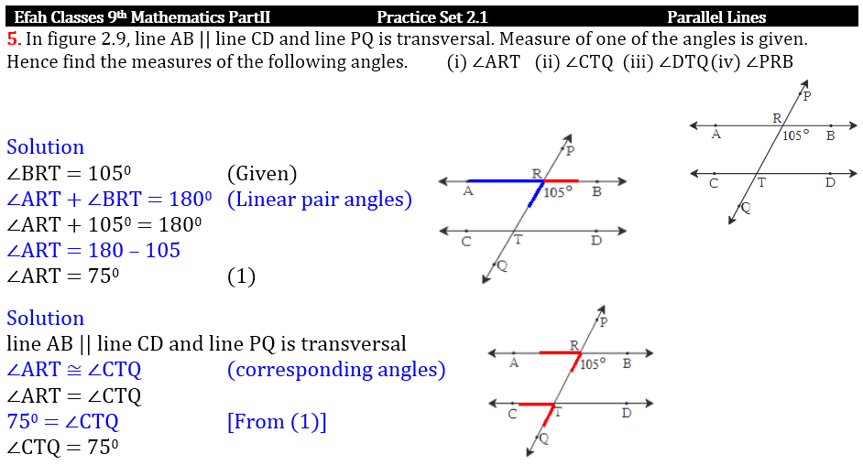

Slide 10
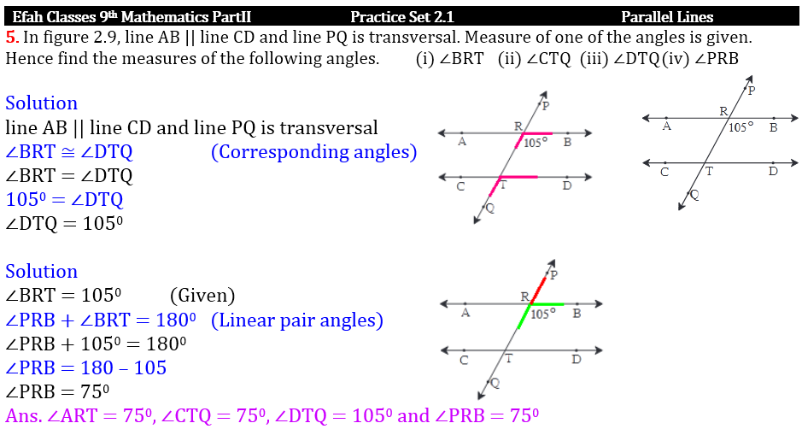

Slide 11
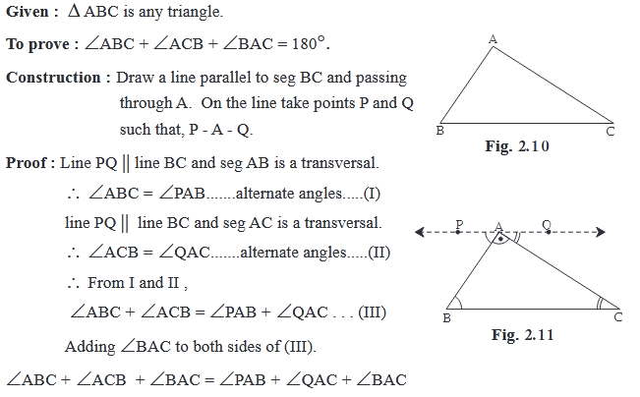
Whether given two lines are parallel or not can be decided by examining the angles
formed by a transversal of the lines.
(1) If the interior angles on the same side of a transversal are supplementary then the lines are parallel.
(2) If one of the pairs of alternate angles is congruent then the lines are parallel.
(3) If one of the pairs of corresponding angles is congruent then the lines are parallel.
If the interior angles formed by a transversal of two distinct lines are supplementary, then the two lines are parallel.
If a pair of alternate angles formed by a transversal of two lines is congruent then the two lines are parallel.
If a pair of corresponding angles formed by a transversal of two lines is congruent then the two lines are parallel.
If a line is perpendicular to two lines in a plane, then the two lines are parallel to each other.
If two lines in a plane are parallel to a third line in the plane then those two lines are parallel to each other. Write the proof of the corollary.

Slide 12
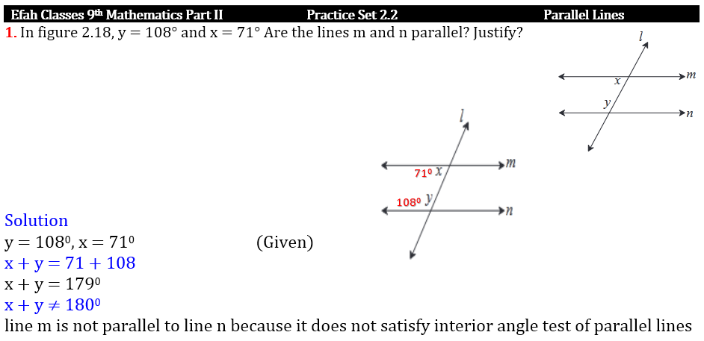

Slide 13
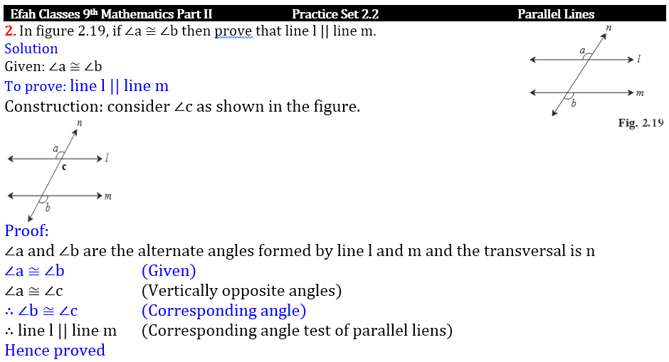

Slide 14
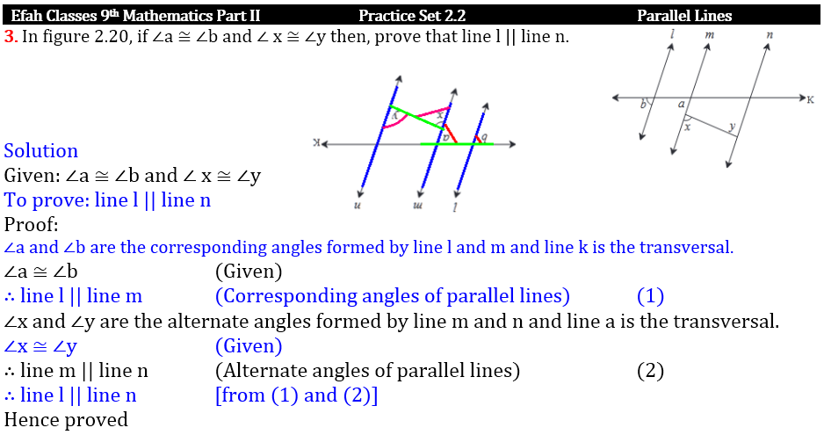

Slide 15
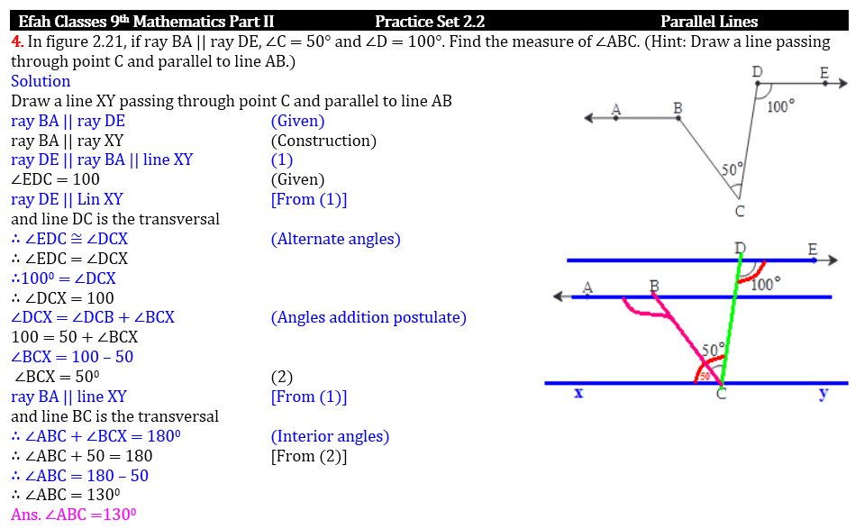

Slide 16
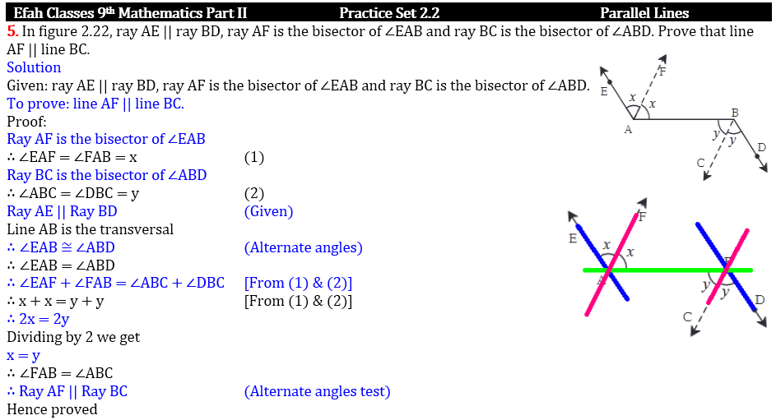

Slide 17
