Slide 1
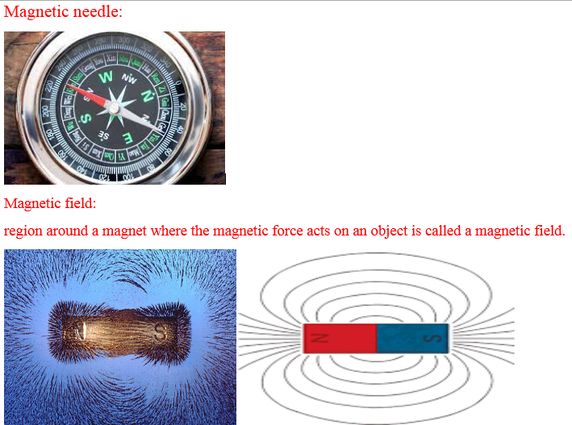

Slide 2
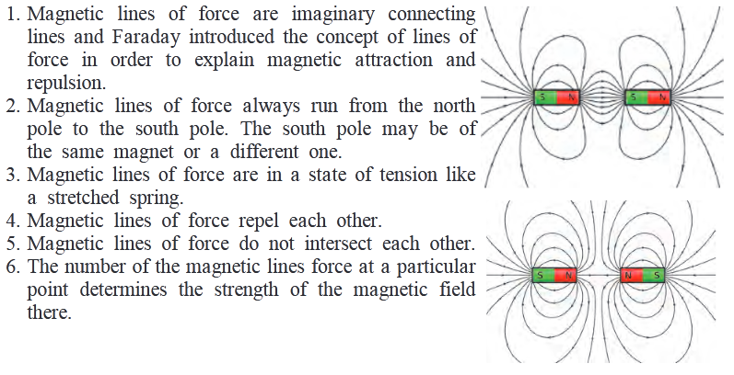

Slide 3
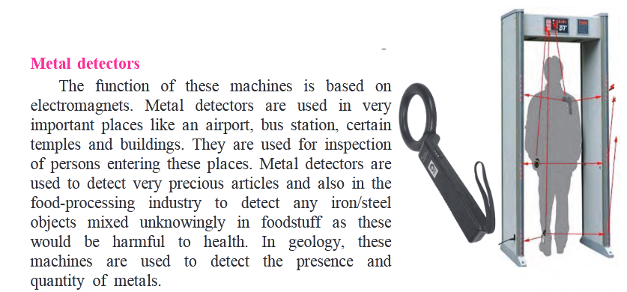


Slide 4
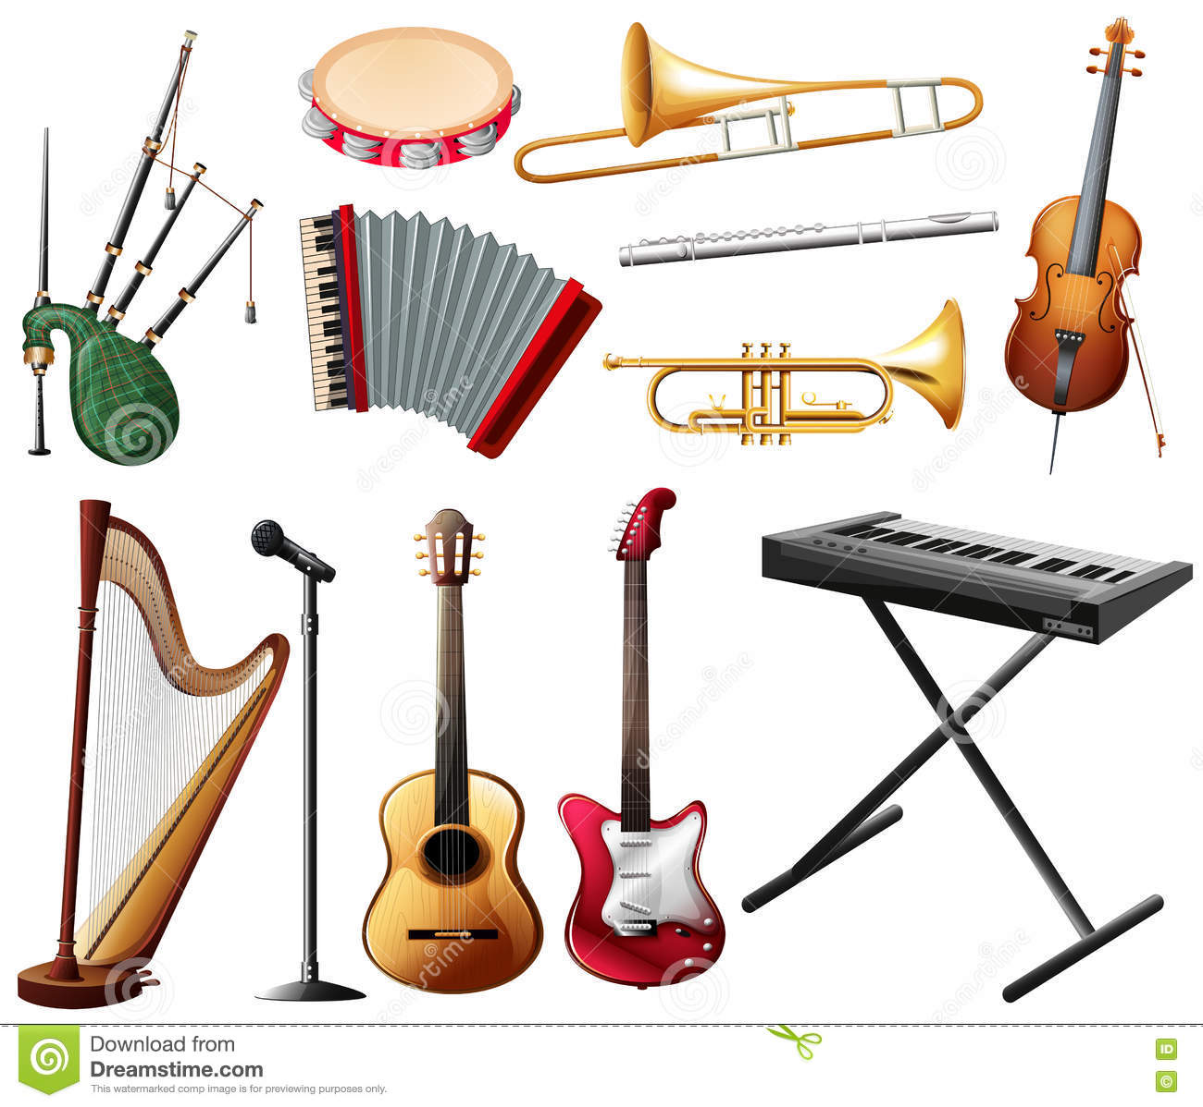
18. Sound: Production of Sound

Slide 5

A swing that moves back and forth like this, is an oscillator.
When the swing moves from one end to the other and returns to its starting point, it is said to have completed one oscillation

Slide 6
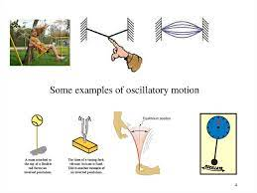

Slide 7
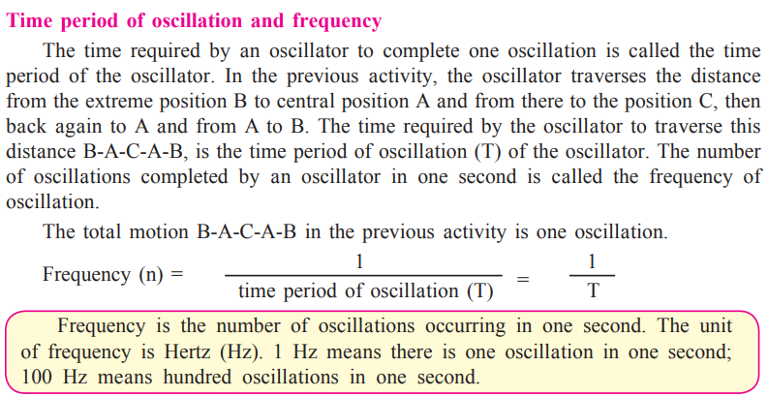

Slide 8
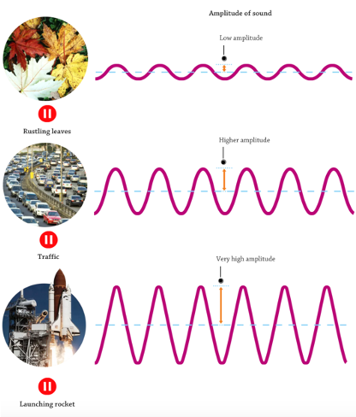

Slide 9
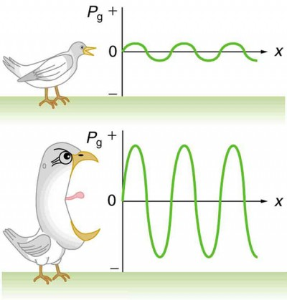

Slide 10
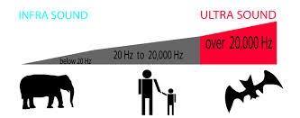

Slide 11
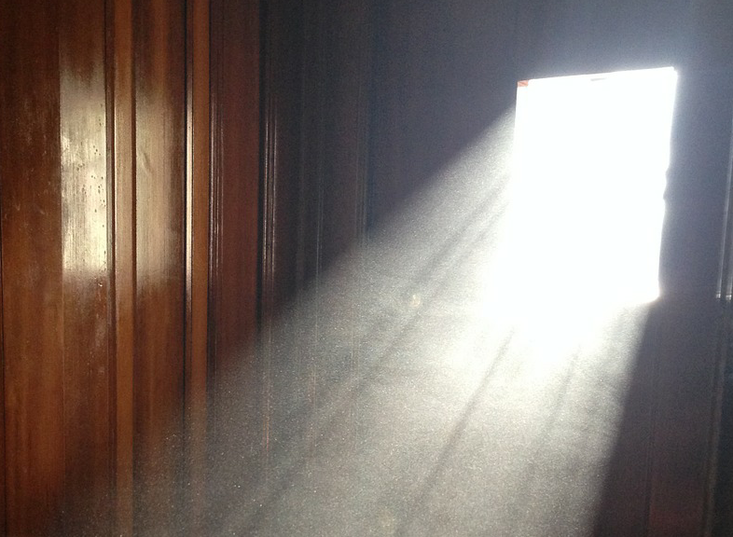

Slide 12
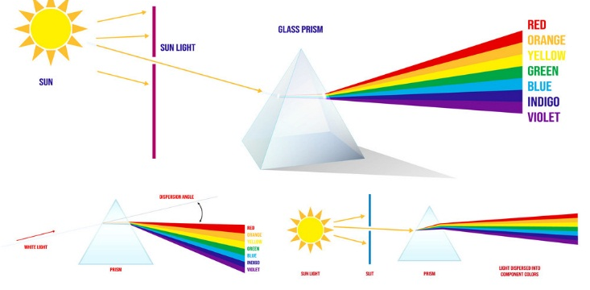

Slide 13
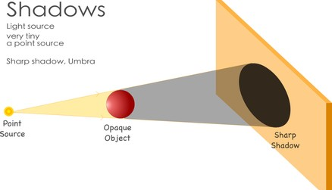

Slide 14
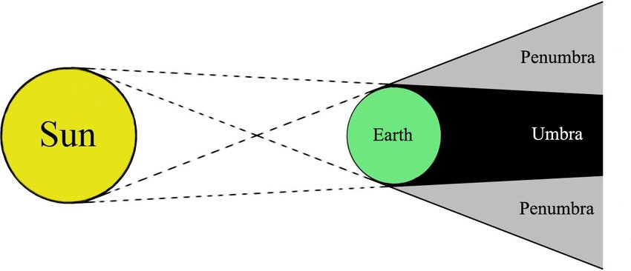

Slide 15
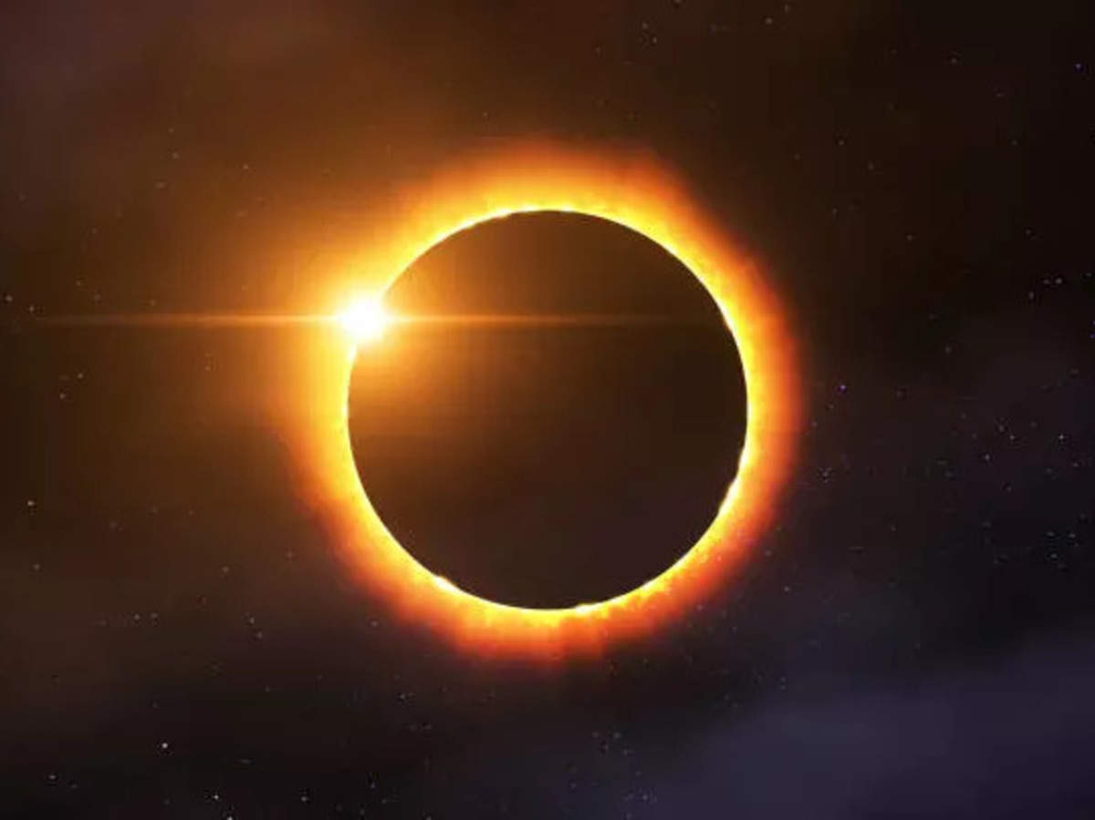

Slide 16
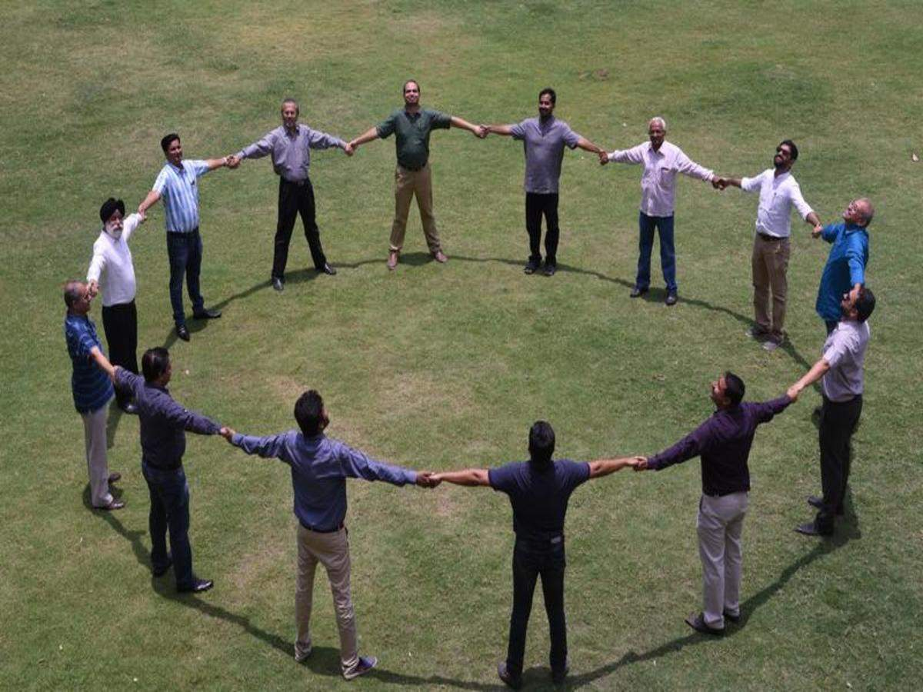

Slide 17
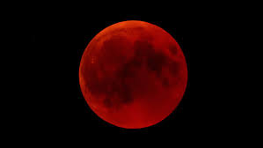

Slide 18
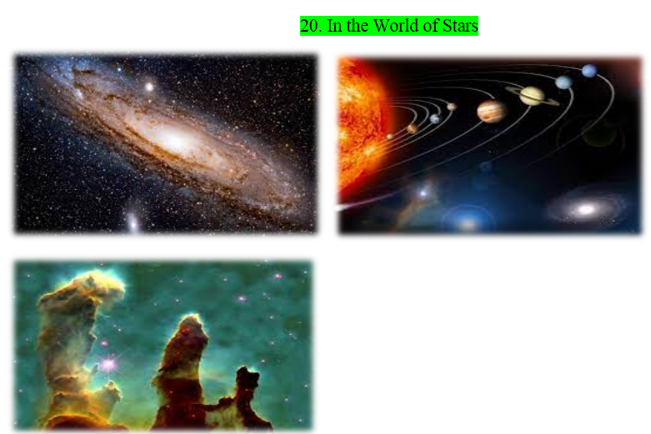

Slide 19
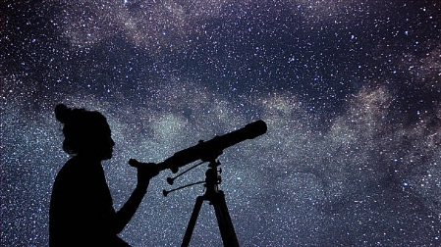
Sky watching

Slide 20
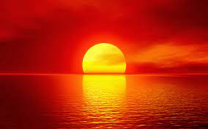
Far away, the sky seems to be touching the ground. The line at which they meet is called the horizon.

Slide 21
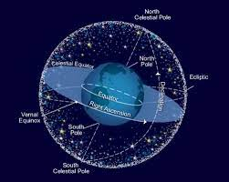
The stars and planets moving in the sky appear to be moving on this sphere. This virtual sphere is called the celestial sphere.

Slide 22
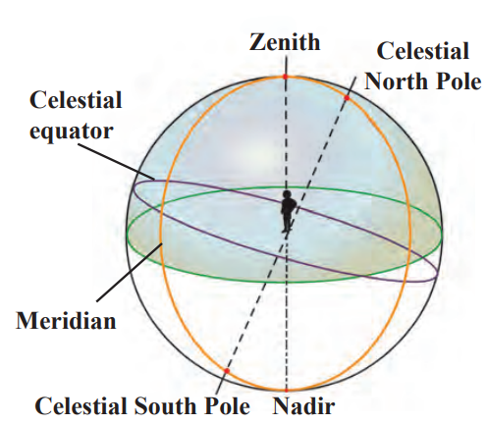
While standing on the ground, the point on the celestial sphere exactly above our head is called the zenith.
If we uniformly expand earth’s equator in all directions indefinitely, it will penetrate the celestial sphere along a circle. This circle is known as the celestial equator. It is in the same plane as the earth’s equator.
The earth moves around the sun, but, seen from the earth, the sun appears to move along a circle on the celestial sphere. This circle describing the apparent motion of the sun around the earth is called the ecliptic.
In astronomy, the great circle which passes through both the celestial poles and the observer’s zenith and nadir is called a meridian.
If we extend the axis of rotation of the earth in the north and south directions it will penetrate the celestial sphere at points called the celestial North Pole and the celestial South Pole, respectively
While standing on the ground, the point on the celestial sphere exactly below our feet is called the nadir

Slide 23
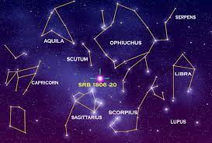
Constellations:
A group of stars occupying a small portion of the celestial sphere is called a constellation

Slide 24
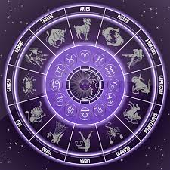
Zodiac sign

Slide 25
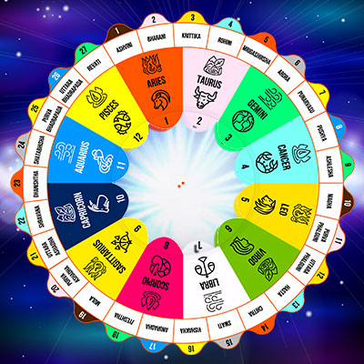
Nakshatra

Slide 26
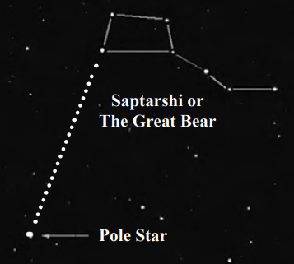
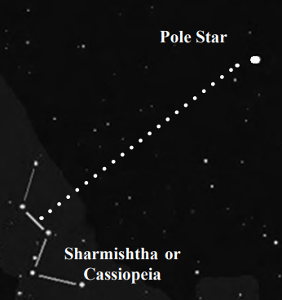
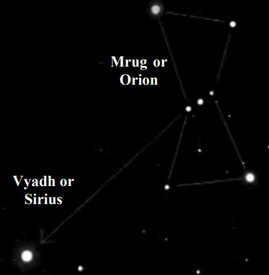
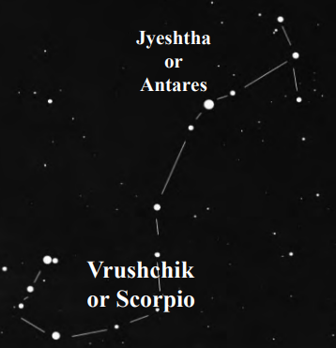

Slide 27
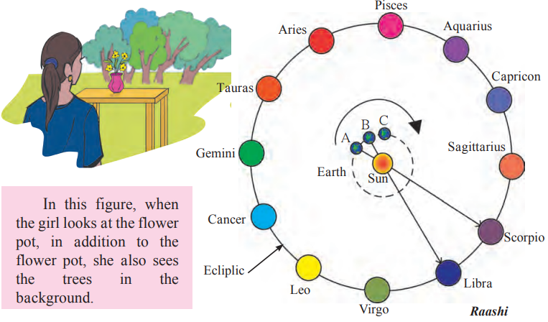

Slide 28
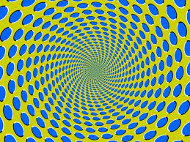
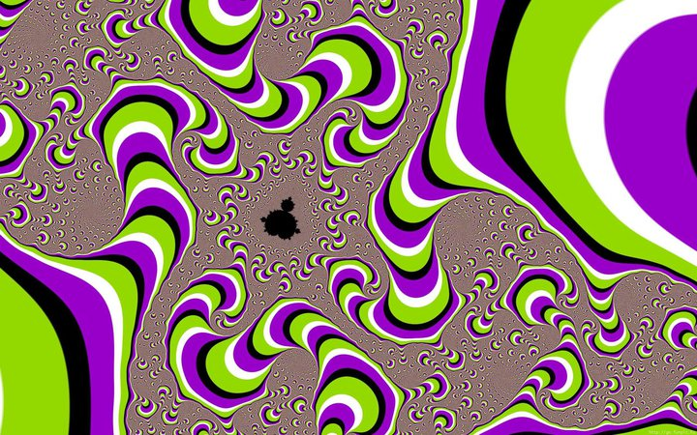
In reality, the sun does not move, but we perceive it as moving due to the motion of the earth around it. This motion of the sun is called its apparent motion

Slide 29
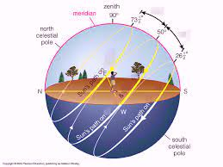

Slide 30
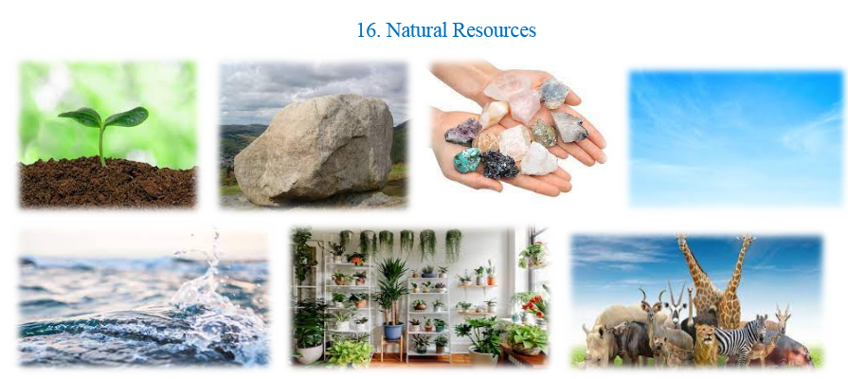

Slide 31
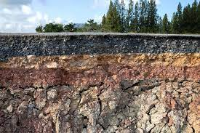
Natural resources in the earth’s crust:

Slide 32
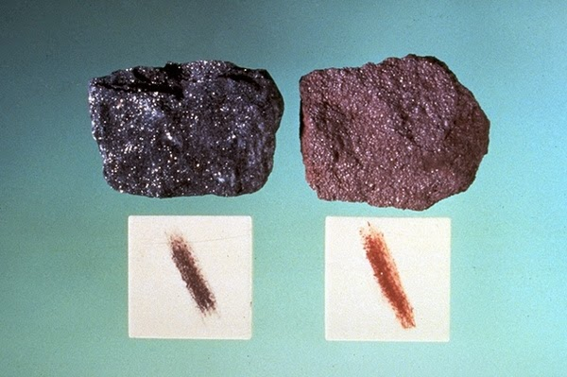
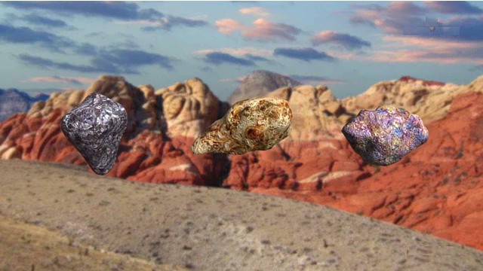
Minerals and ores

Slide 33
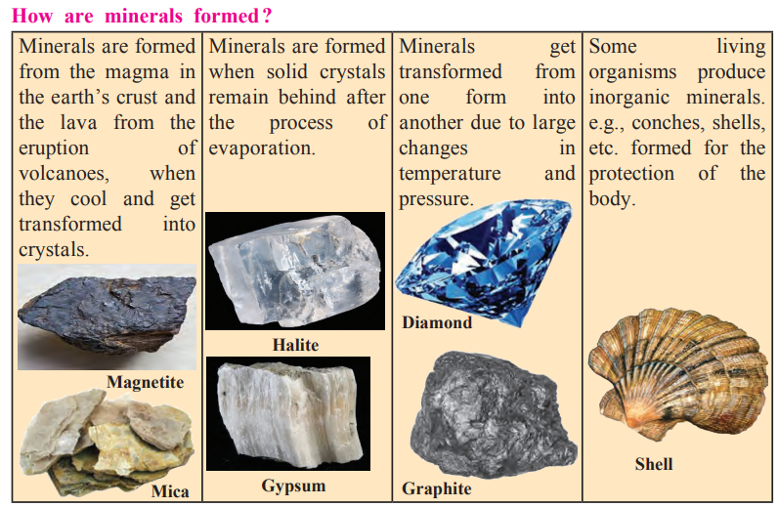

Slide 34
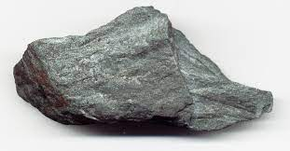
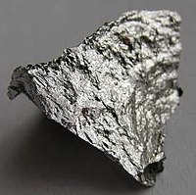
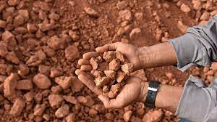
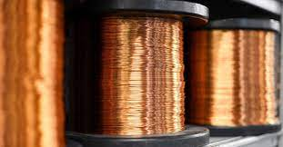
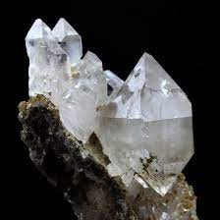

Slide 35


Fuel

Slide 36
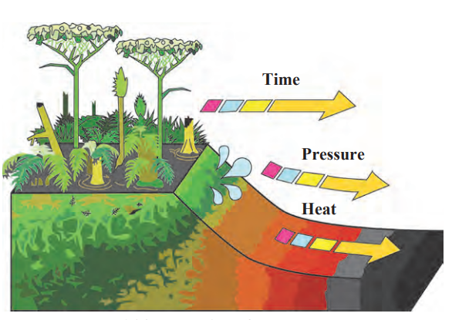
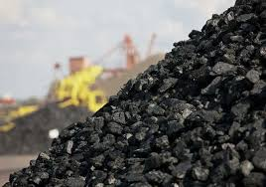
Coal

Slide 37


Slide 38
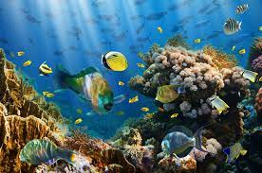
Ocean resources

Slide 39
