Slide 1
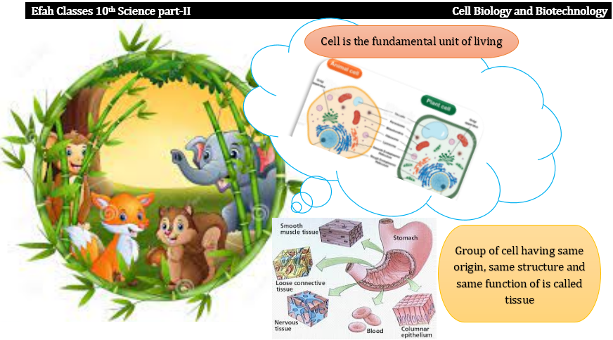

Slide 2
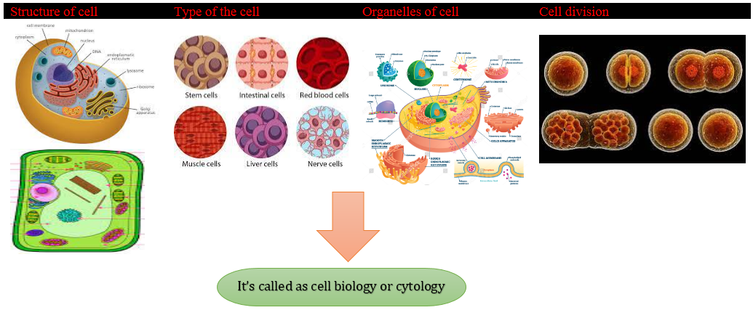

Slide 3
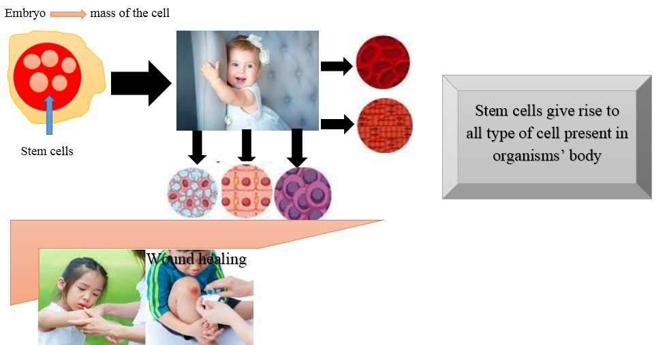

Slide 4
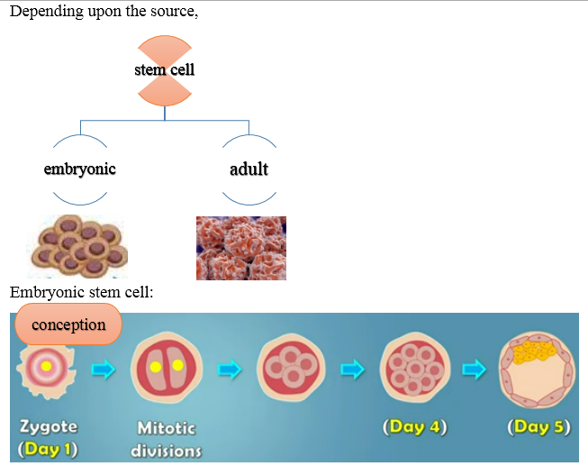

Slide 5

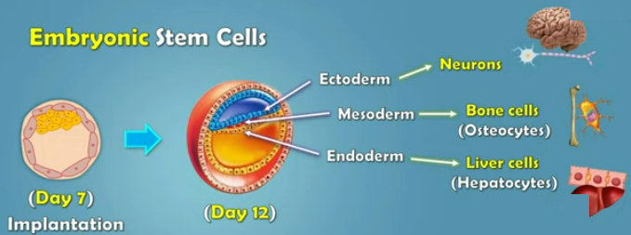


Slide 6
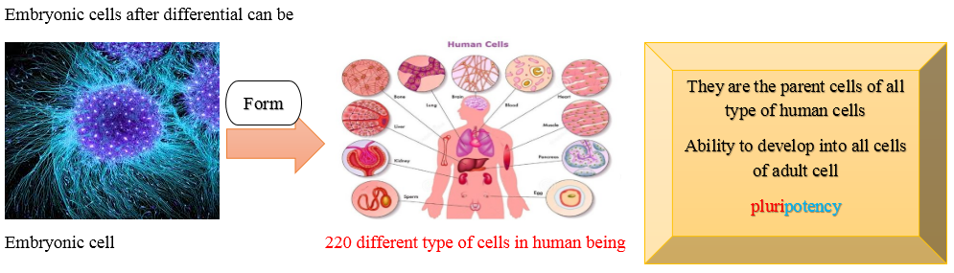

Slide 7
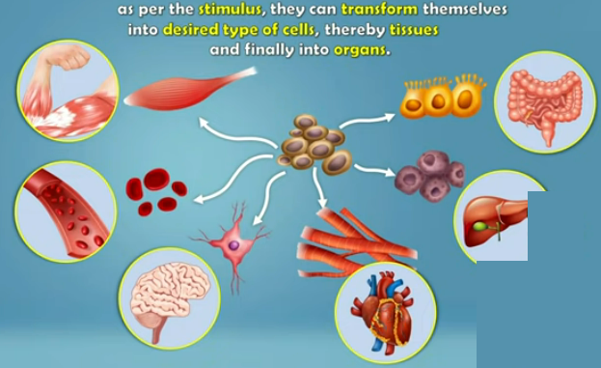

Slide 8
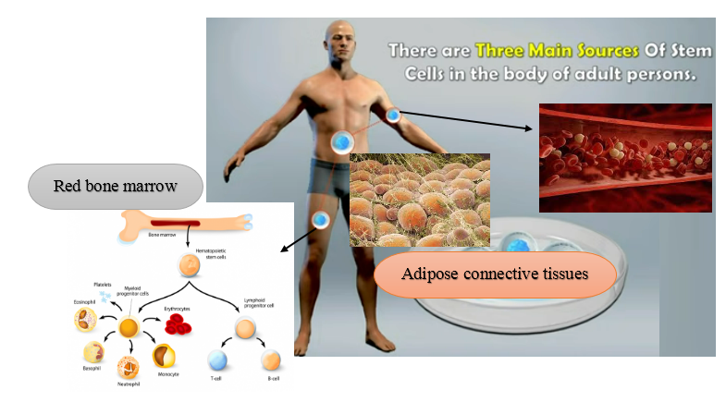

Slide 9
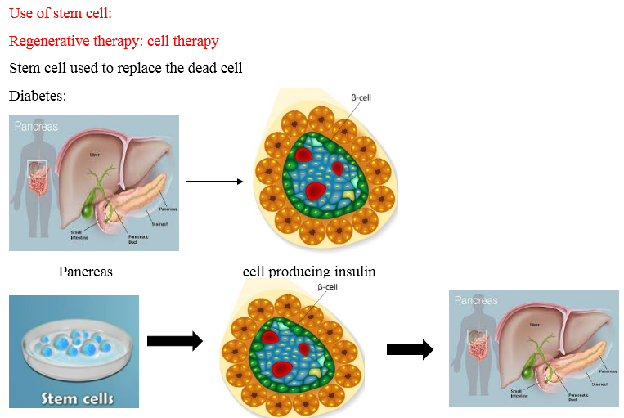

Slide 10
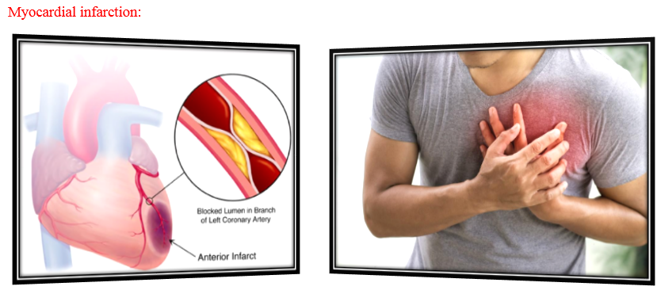

Slide 11
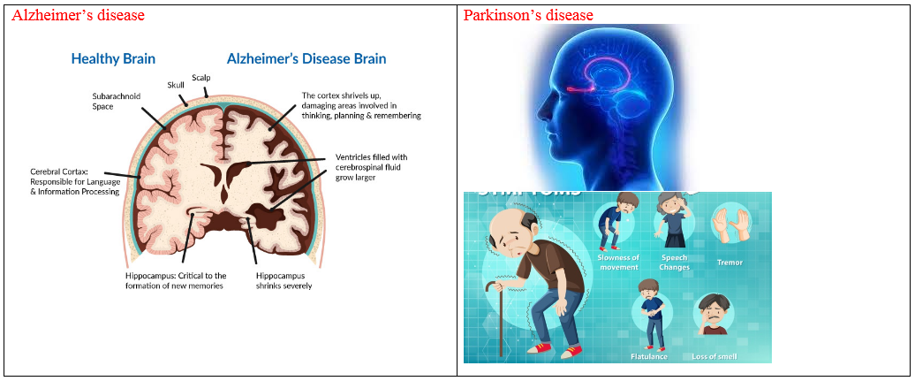

Slide 12
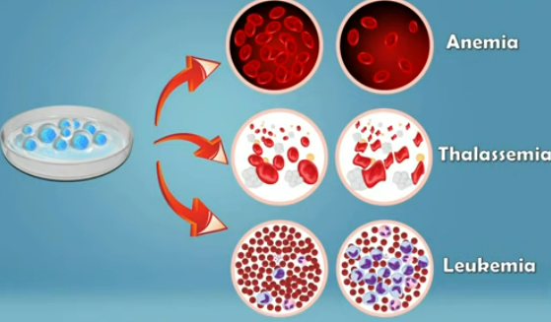

Slide 13
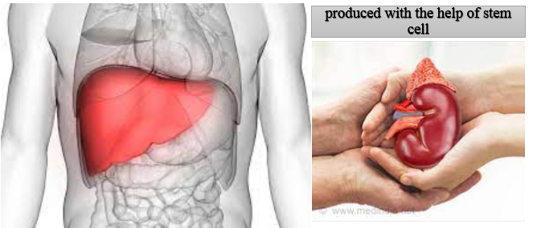

Slide 14


Slide 15
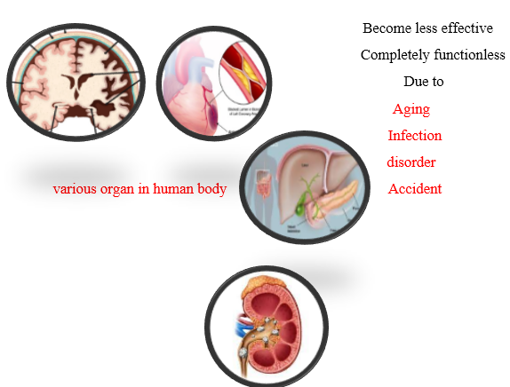

Slide 16


Slide 17
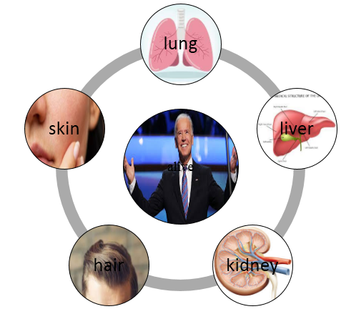

Slide 18
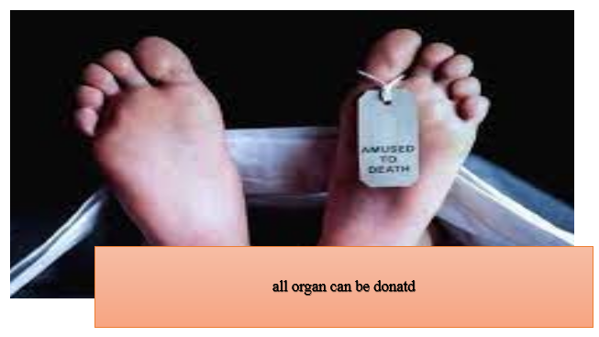

Slide 19
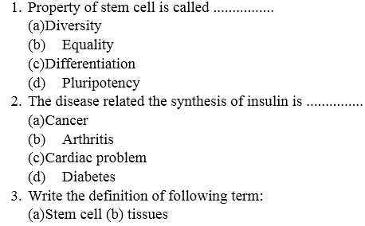

Slide 20
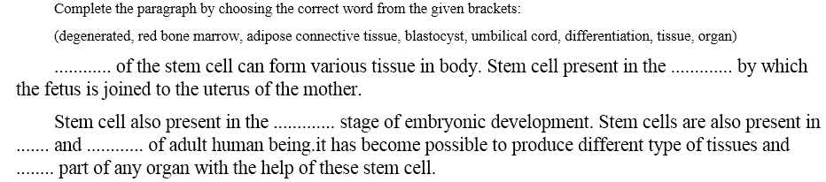

Slide 21
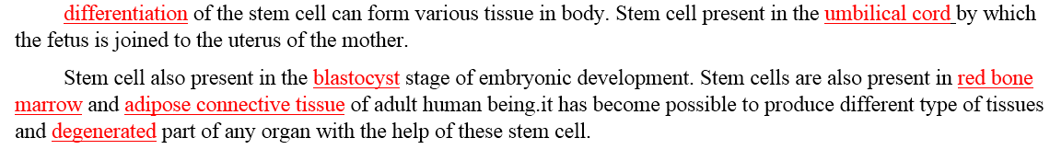

Slide 22
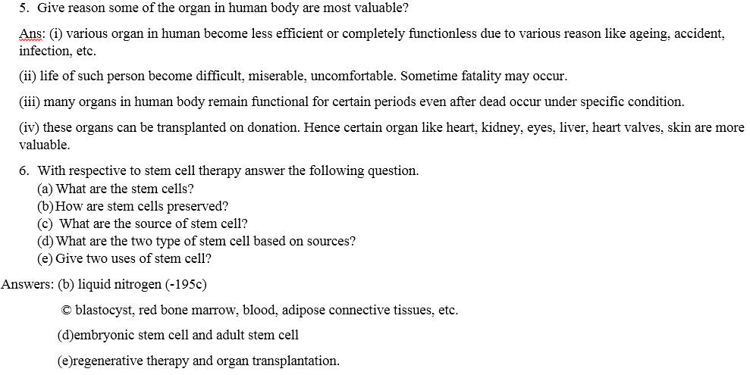

Slide 23
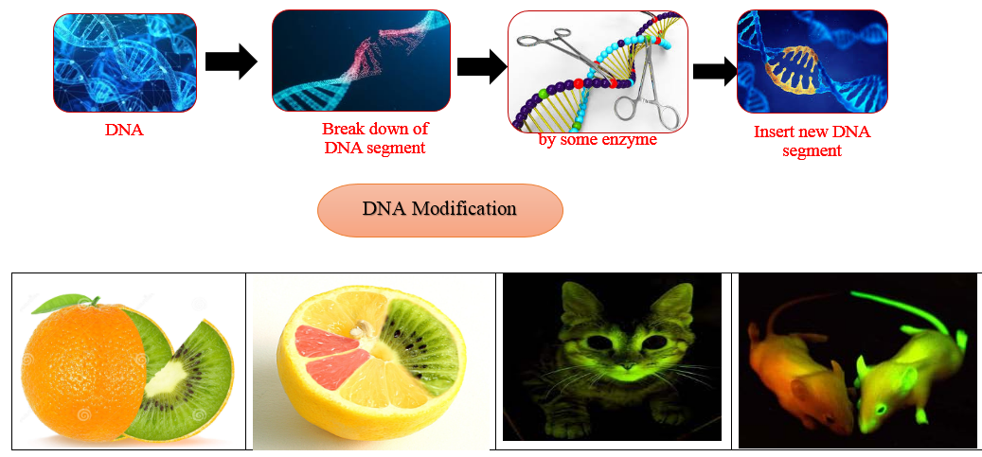

Slide 24
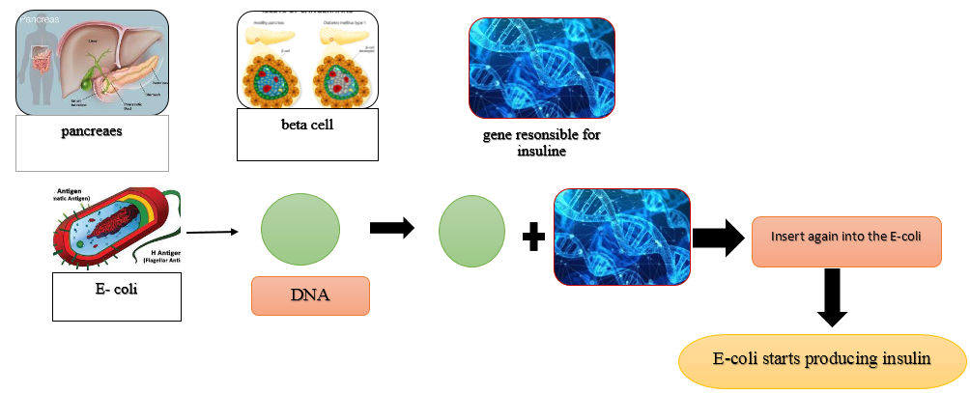

Slide 25
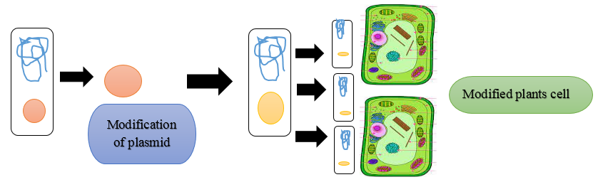
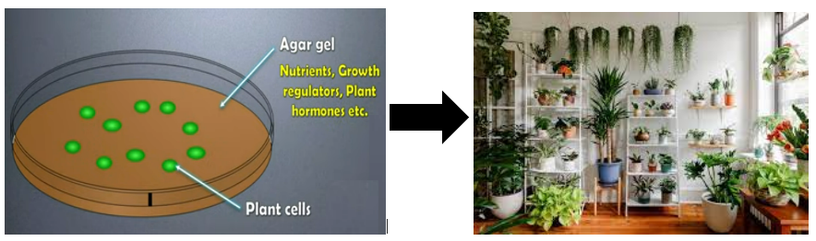

Slide 26
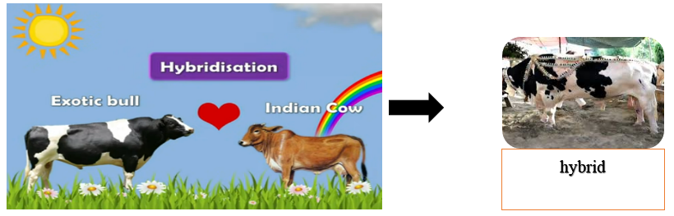
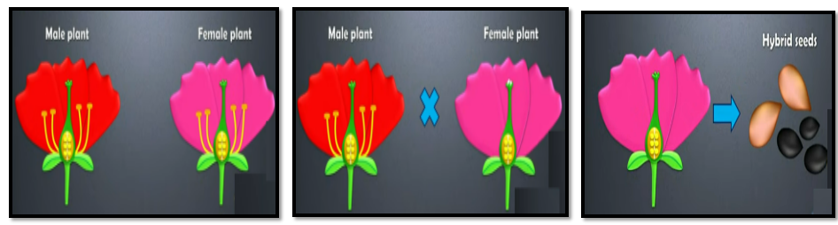

Slide 27
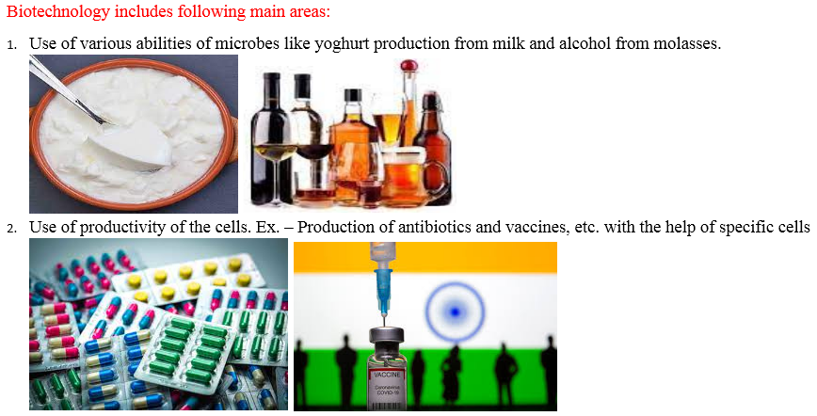

Slide 28
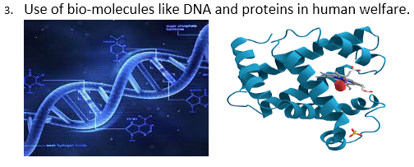

Slide 29
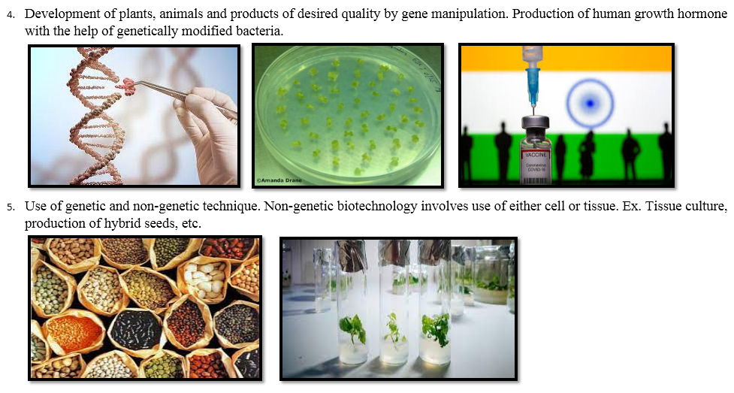

Slide 30
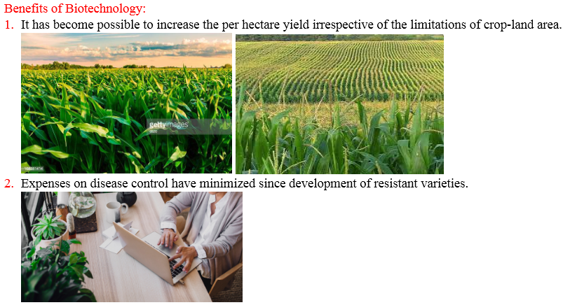

Slide 31
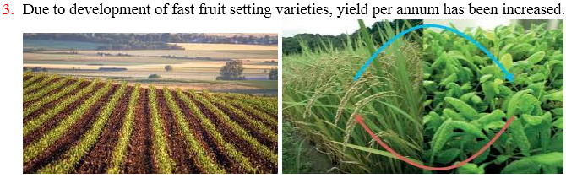
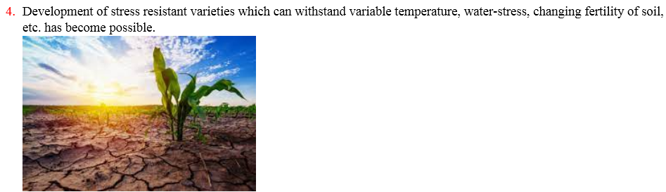

Slide 32
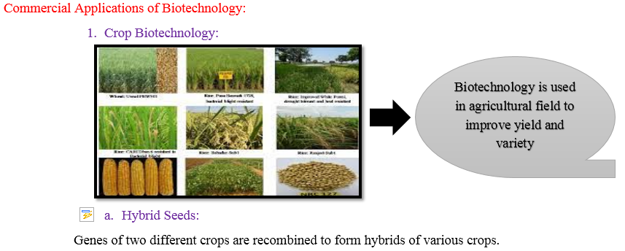
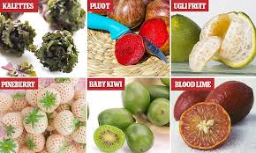
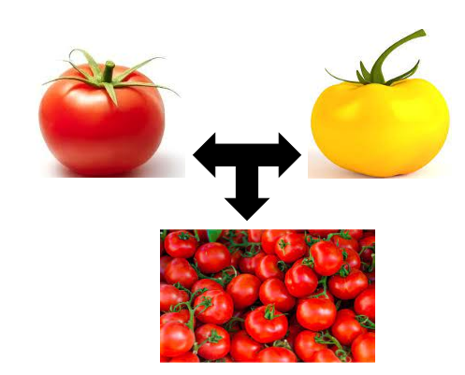

Slide 33
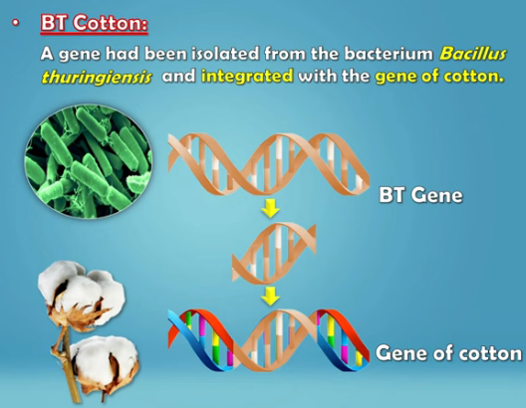
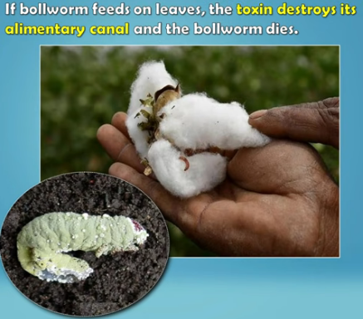
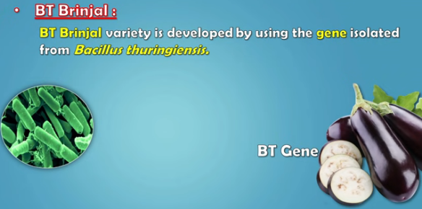
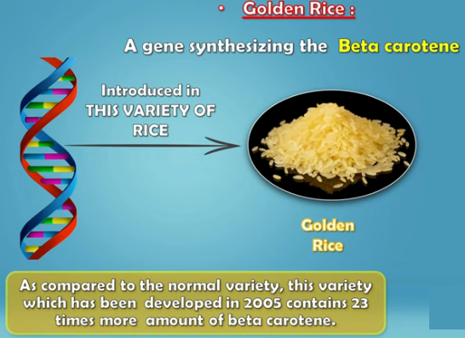

Slide 34
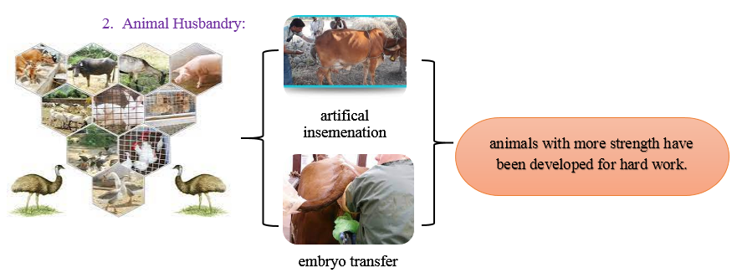

Slide 35
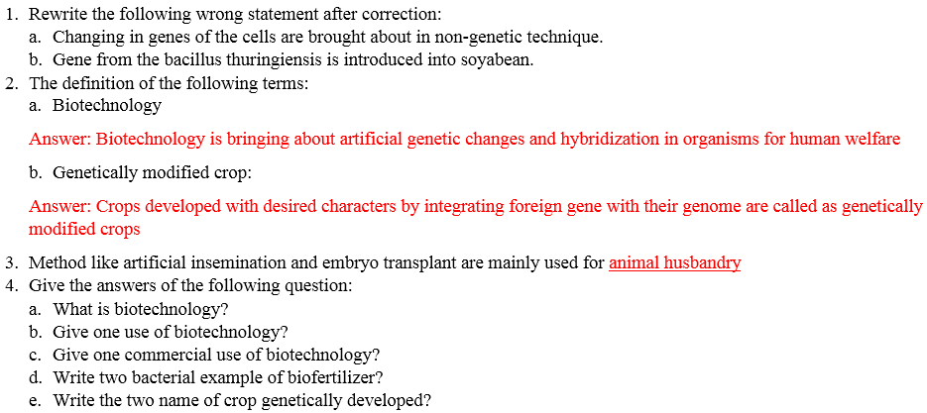
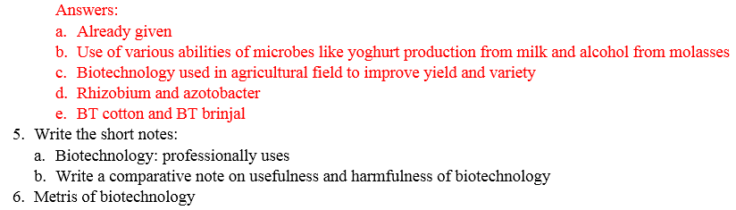

Slide 36
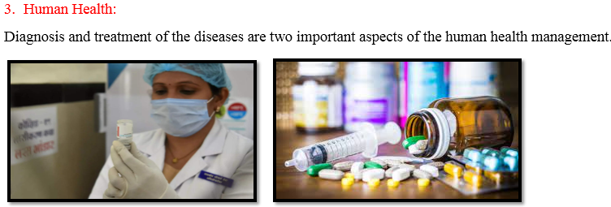

Slide 37
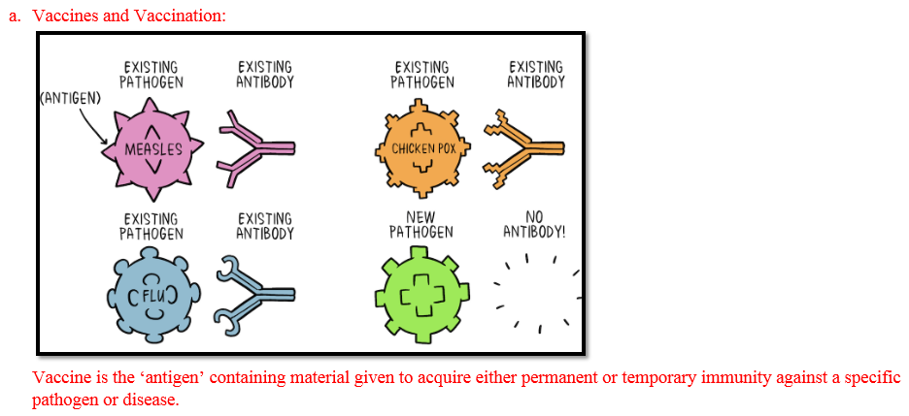
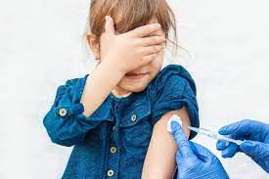

Slide 38
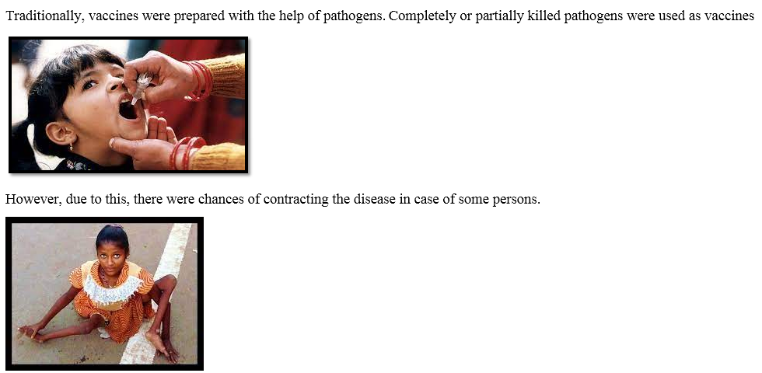

Slide 39
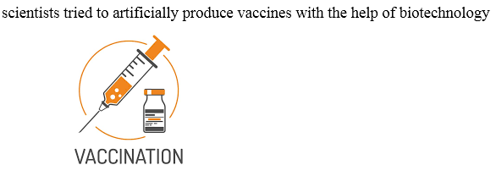

Slide 40
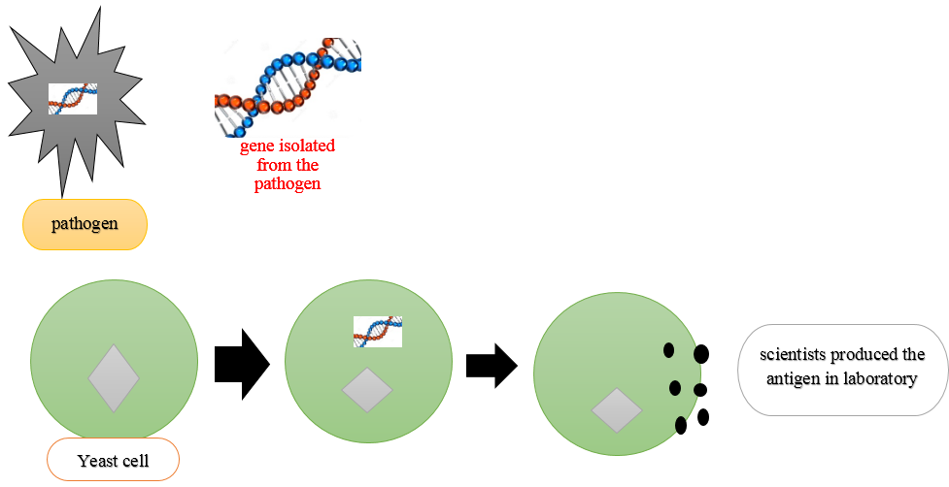

Slide 41
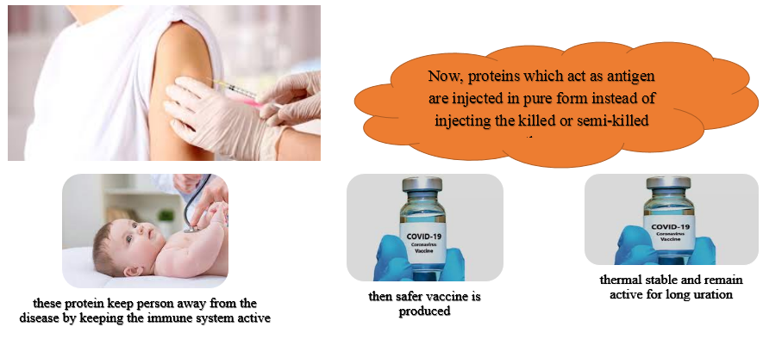

Slide 42
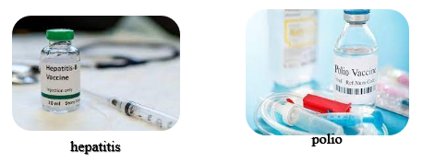


Slide 43


Slide 44


Slide 45


Slide 46


Slide 47


Slide 48


Slide 49


Slide 50


Slide 51


Slide 52

Swage is rich in organic matter
the organic matter in it gets oxidized with the help of dissolved oxygen
If such sewage is released in natural water bodies like rivers

Slide 53



Slide 54


Slide 55


Slide 56

Problems of population explosion were started to appear at the beginning of 20th century.
Almost all the countries, especially underdeveloped and developing countries had been badly affected by the effects of poor quality and quantity of food

Slide 57

Various methods applied for harvesting maximum yield from minimum land are collectively called as green revolution

Slide 58

Improvised dwarf varieties of wheat and rice

Slide 59


Slide 60

Production of various useful aquatic organisms with the help of water is called as blue revolution

Slide 61

Natural fertilizer
Chemical fertilizer

Slide 62

insecticides

Slide 63

Organic farming

Slide 64

Apiculture

Slide 65

Cultivation of Medicinal Plants

Slide 66

Fruit Processing

Slide 67


Slide 68



Slide 69


Slide 70


Slide 71


Slide 72


Slide 73


Slide 74


Slide 75


Slide 76


Slide 77


Slide 78



Slide 79


Slide 80


Slide 81


Slide 82


Slide 83


Slide 84


Slide 85


Slide 86


Slide 87


Slide 88


