Slide 1
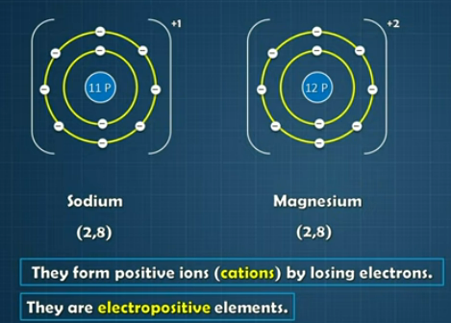
8. Metallurgy
Chemical properties of metals:

Slide 2
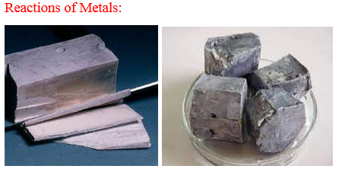
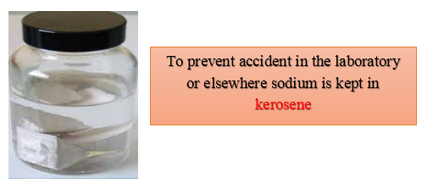

Slide 3
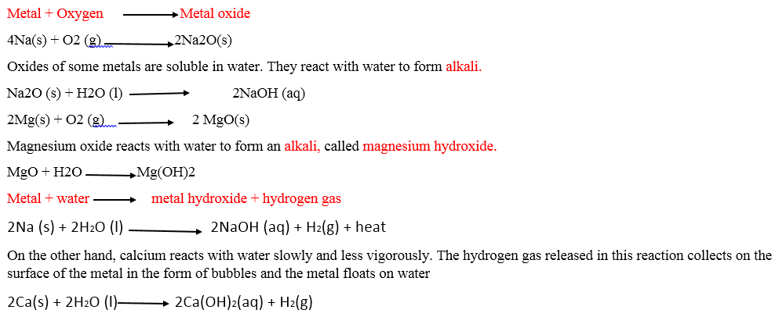

Slide 4
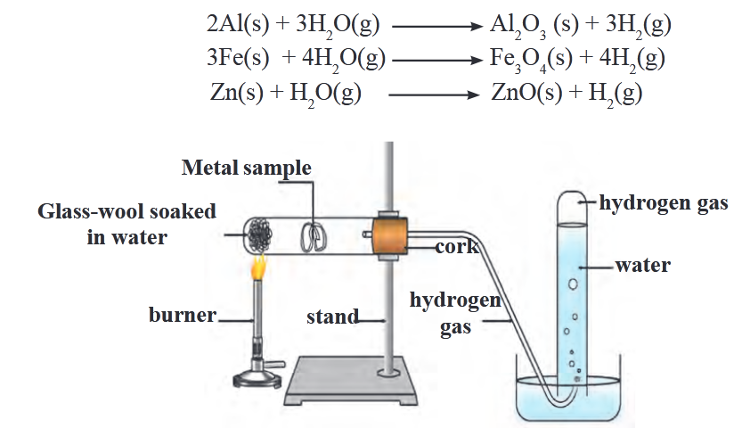

Slide 5
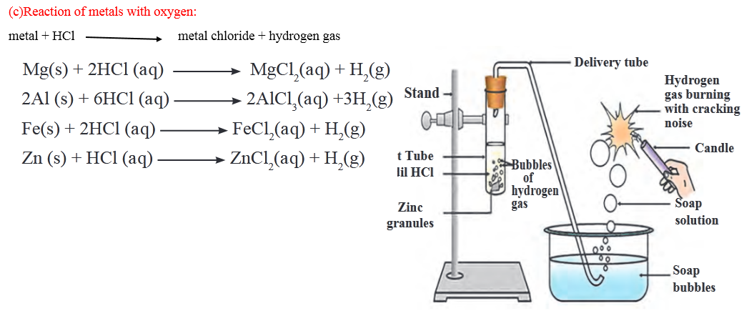

Slide 6
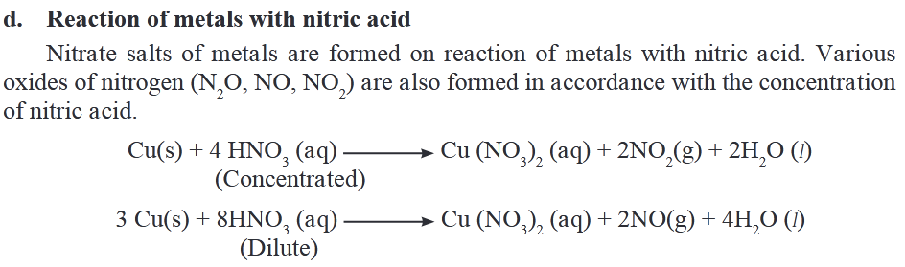


Slide 7
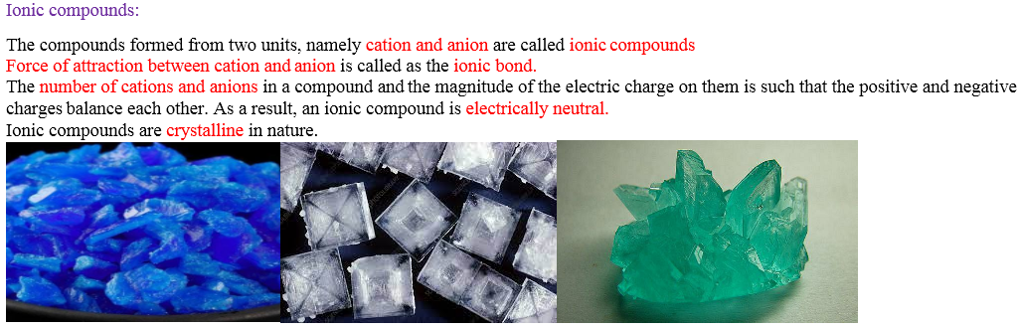

Slide 8
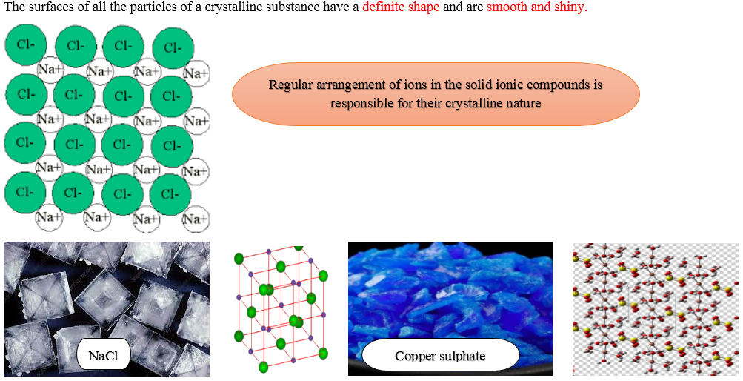

Slide 9
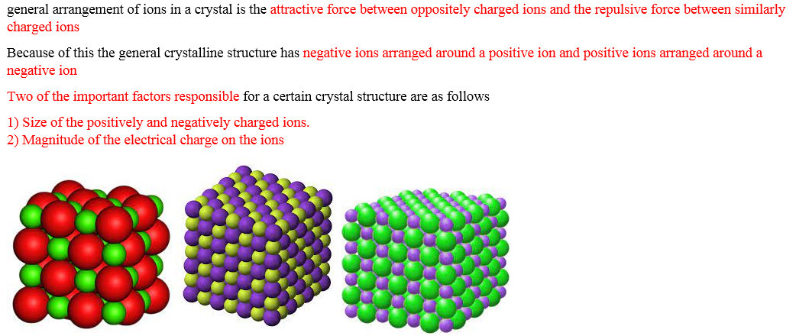

Slide 10
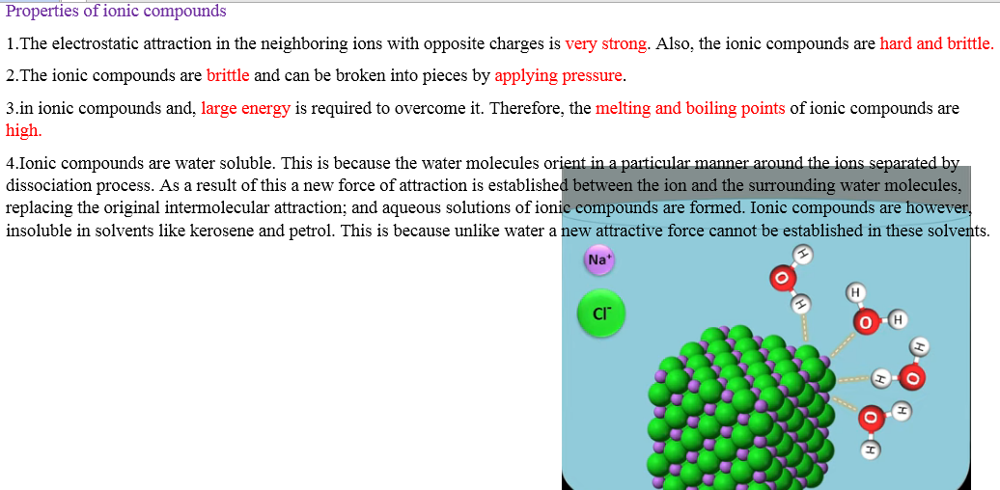
5.The ionic compounds cannot conduct electricity when in solid state In this state the ions cannot leave their places. However, in the fused/molten state they can conduct electricity, as in this state the ions are mobile. The aqueous solutions of ionic compounds conduct electricity as they contain the dissociated ions. On passing current through the solution the ions move to the oppositely charged electrodes. Due to the electrical conductivity in fused and dissolved state the ionic compounds are called electrolytes

Slide 11
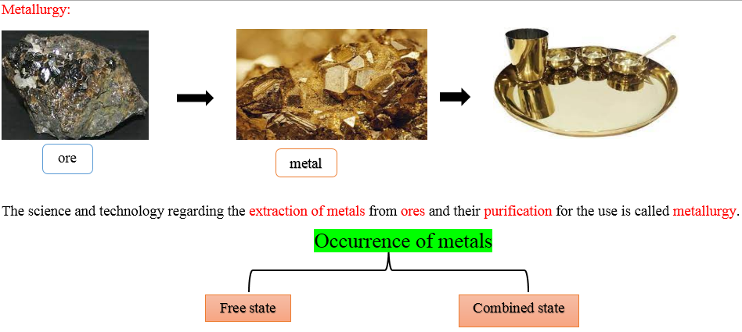

Slide 12
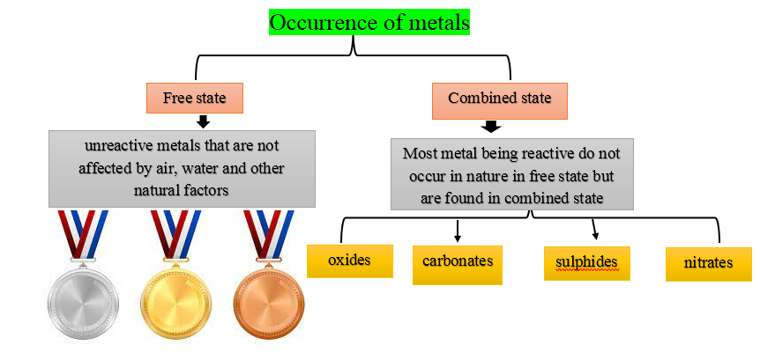

Slide 13
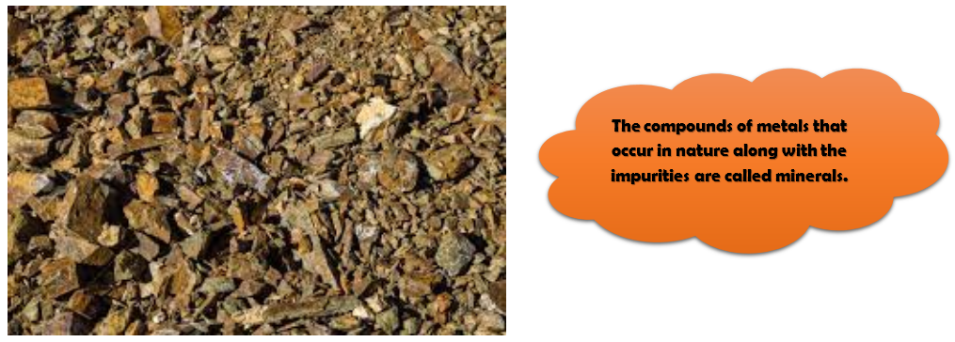
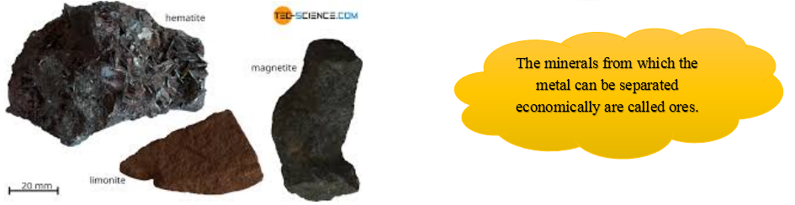

Slide 14
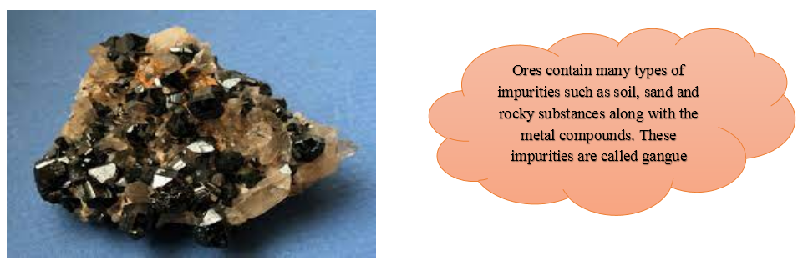
Ores are taken out from the mines and the gangue is usually separated from the ore at the site itself by various methods. Then the ores are carried out to the place where metals are produced. There metals are extracted in pure form. Then metals are further purified by different methods of purification. This entire process is called metallurgy

Slide 15
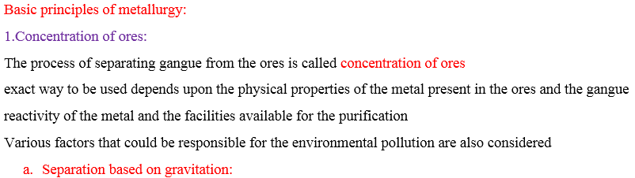

Slide 16
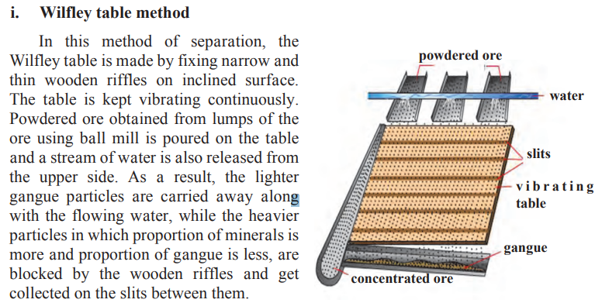
Separation based on gravitation:

Slide 17
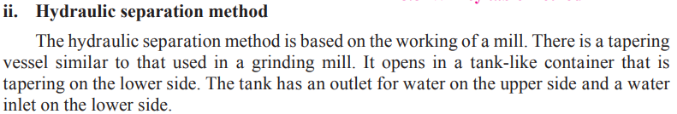
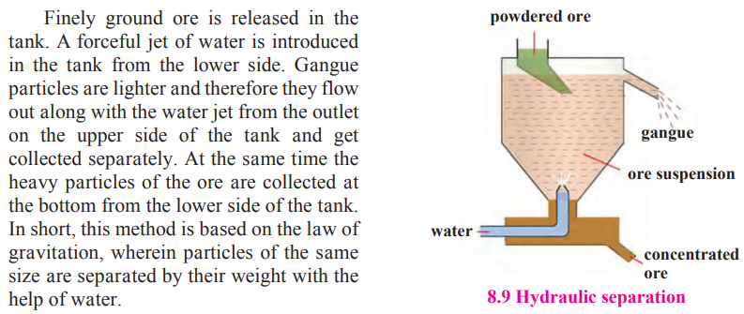

Slide 18
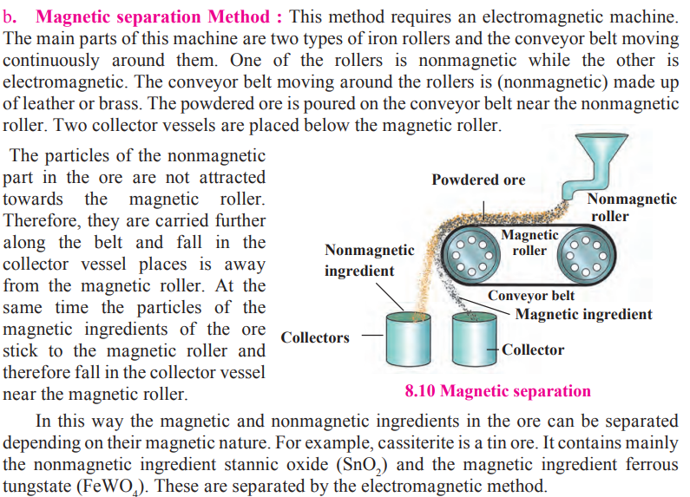

Slide 19
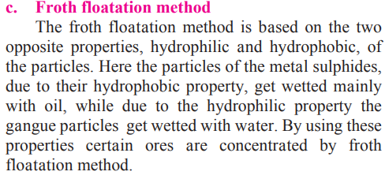
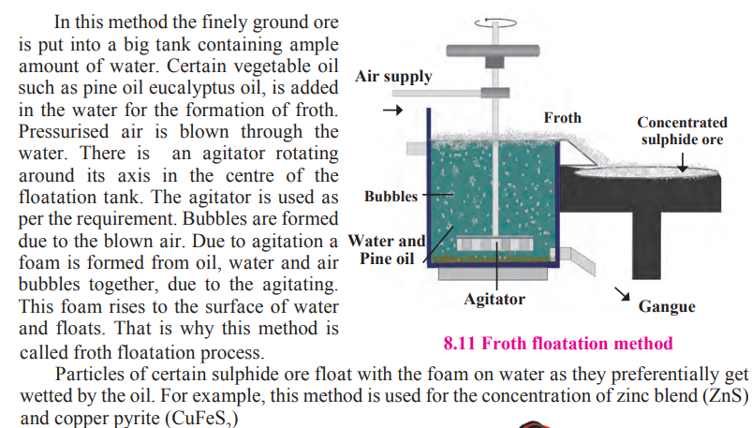

Slide 20
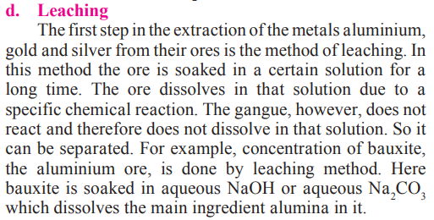

Slide 22
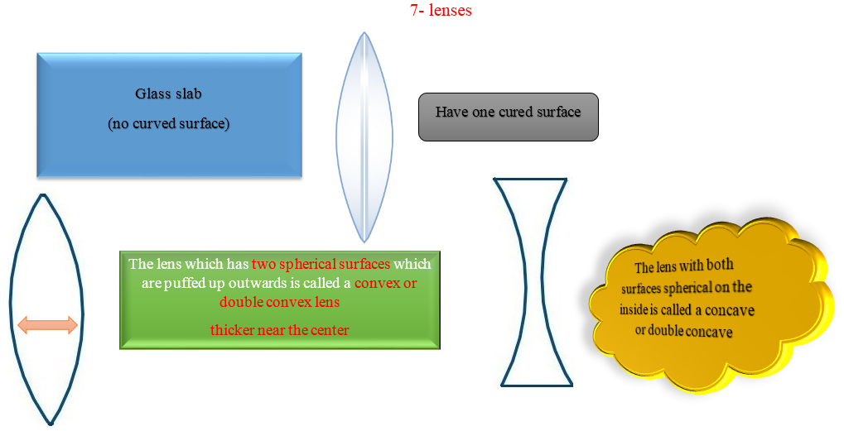

Slide 23
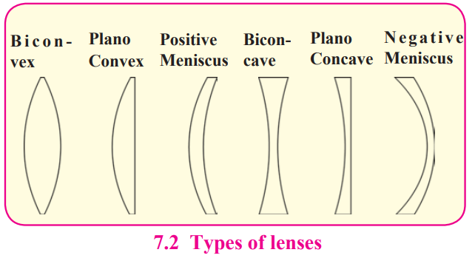

Slide 24
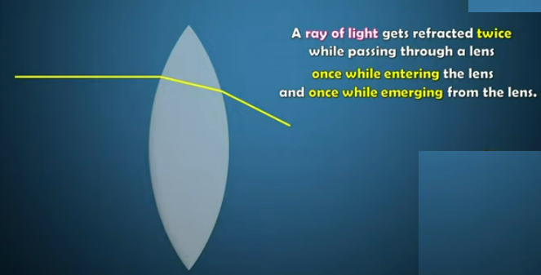

Slide 25
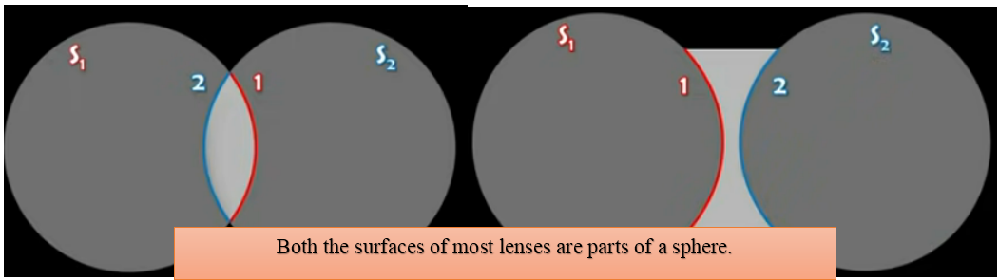
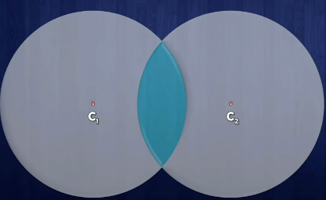
The centers of spheres whose parts form surfaces of the lenses are called centers of curvatures of the lenses

Slide 26
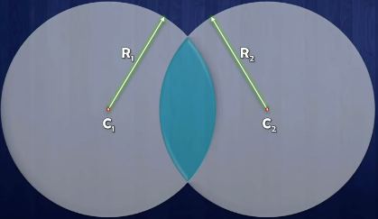
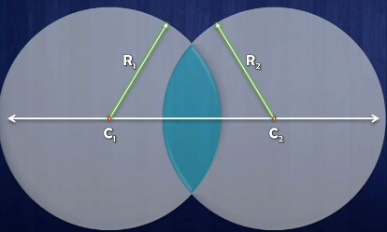
The radii (R1 and R2 ) of the spheres whose parts form surfaces of the lenses are called the radii of curvature of the lens.
The imaginary line passing through both centres of curvature is called the principal axis of the lens.

Slide 27
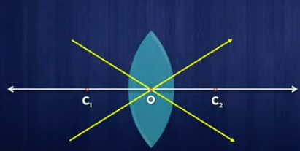
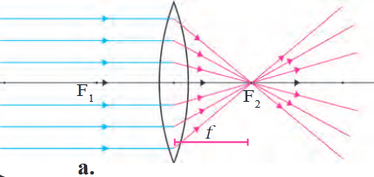
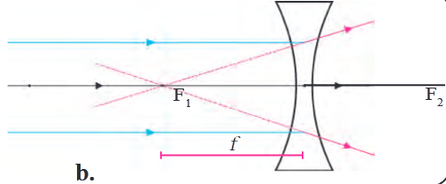
The point inside a lens on the
principal axis, through which light rays pass without
changing their path is called the optical center of a lens.
When light rays parallel to the principal axis are incident on a convex lens, they converge to a point on the principal axis. This point is called the principal focus of the lens.

Slide 28
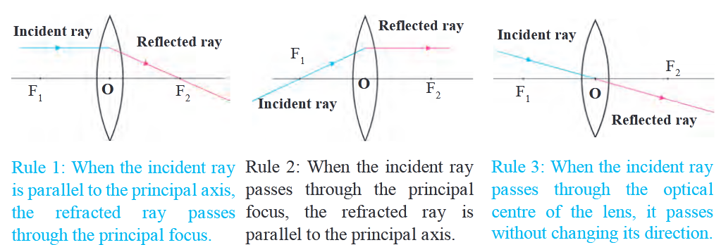

Slide 29
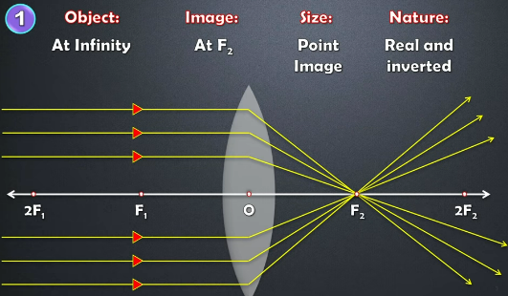

Slide 30
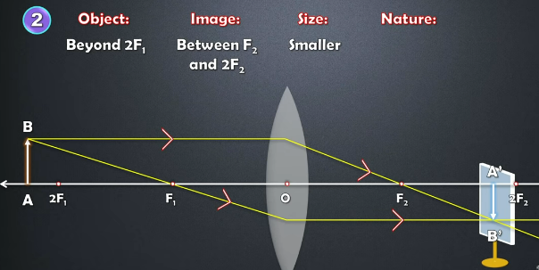

Slide 31
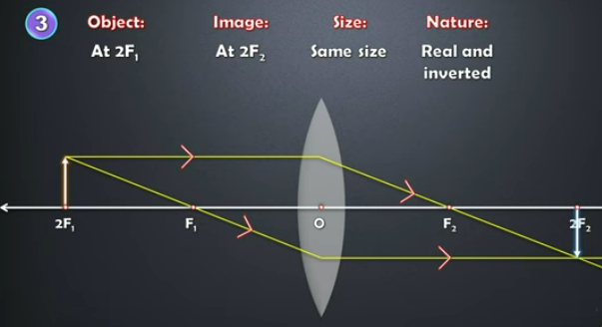

Slide 32

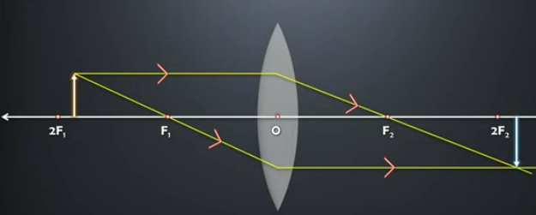

Slide 33
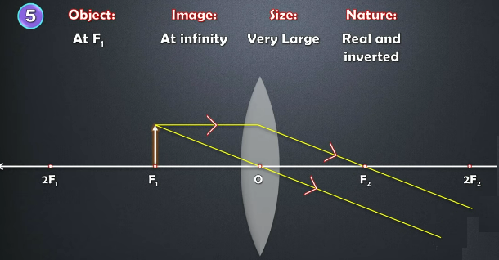

Slide 34
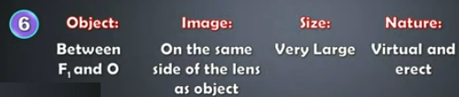
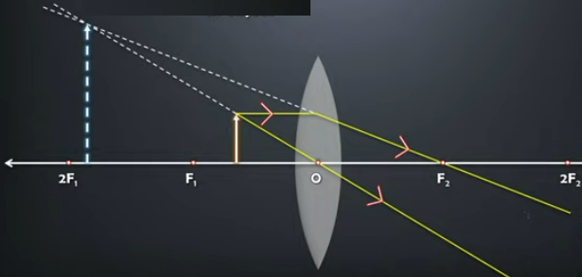

Slide 35
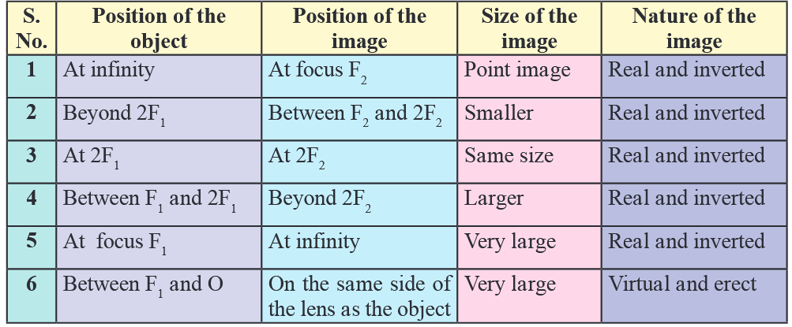

Slide 36
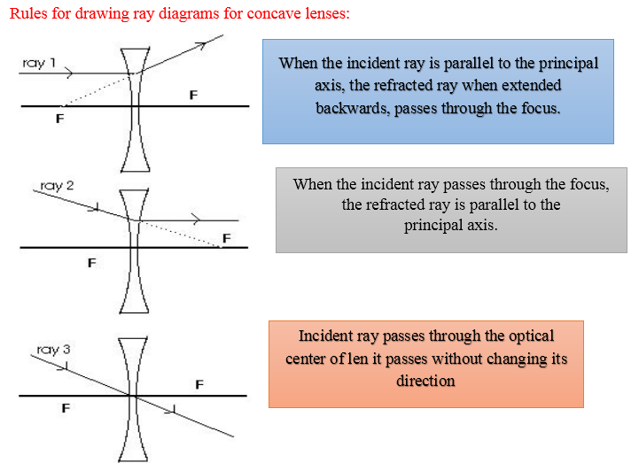

Slide 37
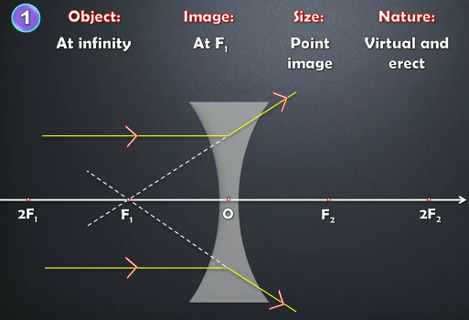

Slide 38
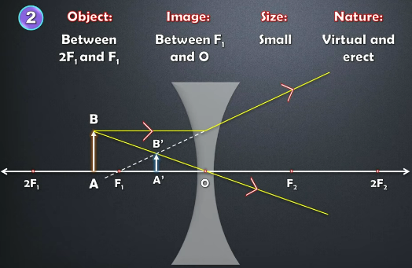

Slide 39
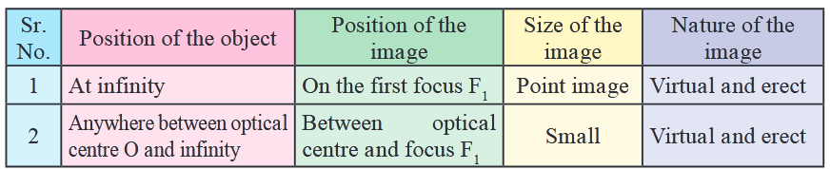
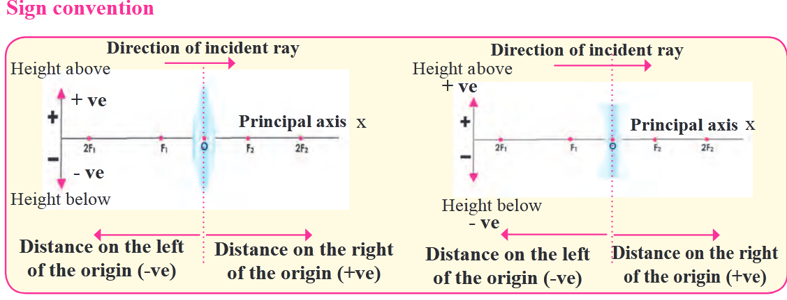

Slide 40
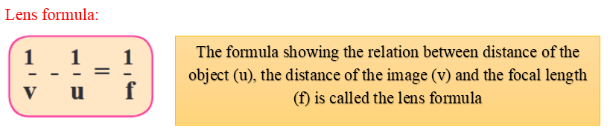
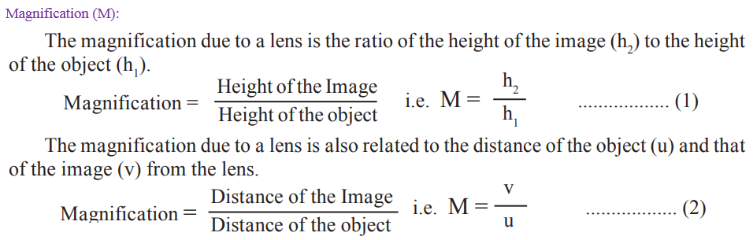

Slide 41



Slide 42

Combination of lenses:

Slide 43


Slide 44


Slide 45


Slide 46


Slide 47


Slide 48

analyses these signal and convert them in such a way that we perceive the object as they actually are

Slide 49


The capacity of the lens to change its focal length as per need is called its power of accommodation.

Slide 50


Slide 51

eye is not at infinity but shifts closer to the eye. In nearsightedness, the image of a distant object forms in front of the retina

Slide 52


Slide 53


Slide 54


Slide 55



Slide 56


Slide 57


Slide 58




Slide 59



Slide 60


